Slide 1


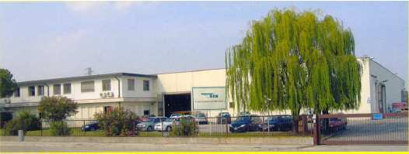
BREWERY HOSES
DISTILLERY HOSES
July 2014

Slide 2

INTRODUCTION
TO
TUBIGOMMA DEREGIBUS SRL
EXCELLENCE IN THE DESIGN AND
MANUFACTURE OF SPECIALTY HOSES

Slide 3
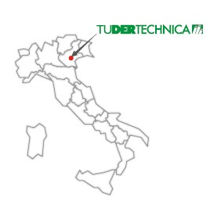
COMPANY PROFILE
PRIVATELY OWNED COMPANY FOUNDED IN 1983 IN PADOVA – ITALY
MODERN/EFFICIENT MANUFACTURING CAPABILITY
- DESIGNS AND PRODUCES TECHNICAL HOSES
- UNI EN ISO 9001:2008 QUALITY CERTIFIED
- OHSAS 18001 – ED 2007 CERTIFIED
- PRODUCTION LENGTHS – 40, 12 METERS
- CONTINUOUS INVESTMENT IN EQUIPMENT
- 80% EXPORT

Slide 4
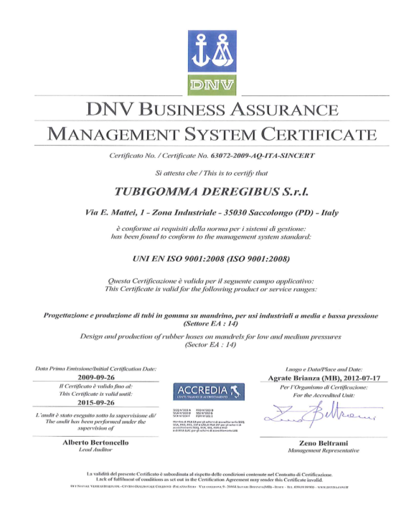
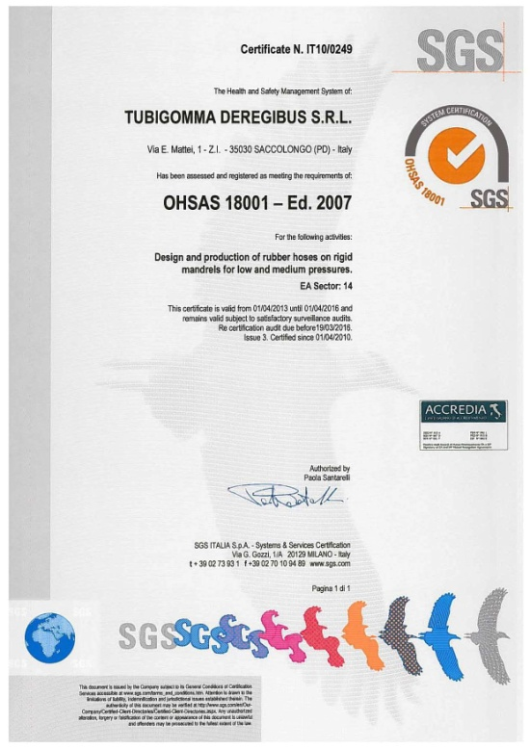

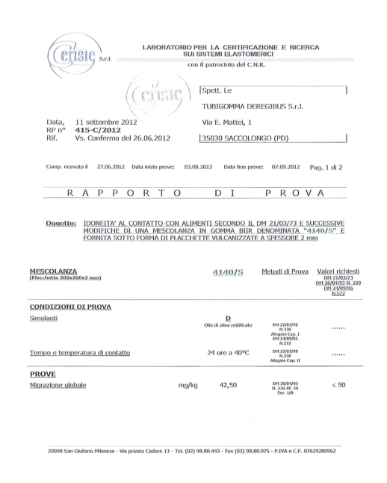

CUSTOMER SERVICE
UNI EN ISO 9001:2008 QUALITY CERTIFICATE
OHSAS 18001 – ED 2007 CERTIFICATE
TEST REPORT BY INDEPENDENT LABORATORY - MIGRATION TESTS
GUIDELINES
CHEMICAL CHARTS

Slide 5
TUDERTECHNICA HOSES
COMPETITIVE ADVANTAGES
Meets international food standards
Stainless steel mandrels (clean and smooth tube)
GALVANIZED/ STAINLESS STEEL WIRE HELICES
superior oxidation resistance

Slide 6
TUDERTECHNICA HOSES
COMPETITIVE ADVANTAGES
Phthalates free tube, tested in compliance with REACH regulation
REPLACE PVC HOSES WHICH ARE NOT PHTHALATES FREE
Wide temperature range
replace pvc hoses which crack in cold temperature AND SOFTEN IN HOT TEMPERATURE
Robust textile construction
superior pressure resistance

Slide 7
TUDERTECHNICA CERTIFICATIONS
INTERNATIONAL STANDARDS TO WHICH TUDERTECHNICA COMPLIES WITH:
FOOD:
  FDA 21 CFR 177.1550, 177.1520, 177.2600 - USA
  D.M. 21/03/73 E SEGUENTI - ITALY
  BfR - GERMANY
  JAPAN MINISTRY OF HEALTH AND WELFARE NOTICE n370, 1959 AND n.201,2006 - JAPAN
  EC 1907/2006 (REACH) - phthalates free
POTABLE WATER:
  KTW, W270
  pharmaceutical and cosmetic:
  USP XXXII, CLASS VI
  ISO 10993 SECT. 5, 10, 11:2009

Slide 8
BREWERY HOSES
TUDERTECHNICA BREWERY HOSES ARE USED AROUND THE WORLD BY MANY COMPANIES AND AMONG THEM:
    MILLER-COORS (USA)
    AMBEV (BRAZIL)
    HEINEKEN (EUROPE)
    ANHEISER BUSCH (USA)
    SAMUEL ADAMS (USA)
    TSINGTAO (CHINA)
    CERVECERIA QUILMES (ARGENTINA)
    KIRIN BRASIL (BRAZIL)
    TUI (NEW ZEALAND)

Slide 9
CLEANING AND DISINFECTION
IN BREWERY INDUSTRY
MICROBREWERY
NOT AUTOMATED BREWERY
AUTOMATED BREWERY
1- HOSE REMOVED FROM PRODUCTION LINE
C. I. P.
2- RINSING
3- CLEANING/DISINFECTING
4- RINSING

Slide 10
BREWERY HOSES
OFF LINE CLEANING METHOD
NOT AUTOMATED BREWERIES NEED FREQUENT CLEANING AND DISINFECTING PROCESS
PREMIUM GRADE LOW PERMEATION RUBBER COMPOUND
10 BAR WORKING PRESSURE CONSTRUCTION
FLEXIBILITY AND LIGHT WEIGHT
Notes:
General information about the brewery:
1. They clean the hose up to 3 times a week on hoses used for an Identical brew.
2. They clean the hose every time when they change brews.
Washing and disinfecting the hoses:
1 step. They wash the hose with hot drinking water.
2 step. They wash the hose with chemicals for 45 min at @ 62-65 degrees C:
a) Their chemicals is Peracetic Acid used at 3% concentration.
b) With heavily flavored brews they may use instead Nitric Acid (HNO3) or Phosphoric Acid (HPO3) at 3%.
3 step. After the washing with chemicals (point 2) they IMMEDIATELY clean the hose with hot water & steam for @ 10-15 minutes.
Peracetic Acid is the combination of Acetic Aid & Hydrogen Peroxide. This was developed in 1987 to kill the Legionaria Bacteria discovered at the Legionnaires Conference in NYC that was known as Legionnaires Disease. It is very widely and commonly used in most food handling equipment and apparatus because of how easy it cleans up. The by-products after adding water at 23 degrees C is Oxygen (O2), Carbon Dioxide (CO2), and water (H2O), while leaving no trace of the Peracetic acid.

Slide 11

TUFOOD/EPDM
Suction and delivery hose suitable for a wide range of food products. Not recommended for fatty food products and oil.
TUBE: EPDM, white
    phthalates free, tested in compliance with REACH regulation
    FDA 21 CFR 177.2600
    BFR recommendation XXI cat 2
    DM 21.03.73 e seguenti
    EUROPEAN REGLEMENT 1935/2004/CE
    JAPAN-Ministry of Health and Welfare Notice No.370,1959 and No.201, 2006
    Ral registration G-74

Slide 12
TUFOOD/EPDM
Suction and delivery hose suitable for a wide range of food products. Not recommended for fatty food products and oil.
REINFORCEMENT: synthetic plies - galvanized wire helices
COVER: smooth, red, abrasion, ageing and ozone resistant, cloth finish
WP: 10 BAR (150 PSI) BP: 30 BAR (450 PSI)
VACUUM: 675 mmHg (0,9 bar)
T: -40°C / +120°C ( -40°F / +248°F )

Slide 13
TUPRESTIGE
Premium grade low permeation suction and delivery hose suitable for a wide range of products. Recommended for wine and spirits.
TUBE: IIR, white
    phthalates free, tested in compliance with REACH regulation
    FDA 21 CFR 177.2600
    DM 21.03.73 e seguenti
    EUROPEAN REGLEMENT 1935/2004/CE
    JAPAN-Ministry of Health and Welfare Notice No.370,1959 and No.201, 2006

Slide 14
TUPRESTIGE
Premium grade low permeation suction and delivery hose suitable for a wide range of products. Recommended for wine and spirits.
REINFORCEMENT: synthetic plies - galvanized wire helices
COVER: smooth, red, abrasion, ageing and ozone resistant, cloth finish
WP: 10 BAR (150 PSI) BP: 30 BAR (450 PSI)
VACUUM: 675 mmHg (0,9 bar)
T: -40°C / +120°C ( -40°F / +278°F )

Slide 15
BREWERY HOSES
CIP CLEANING METHOD
AUTOMATED BREWERIES NEED FREQUENT CLEANING AND DISINFECTING PROCESS
PREMIUM GRADE LOW PERMEATION RUBBER COMPOUND
ROBUST CONSTRUCTION WITH 16 BAR WORKING PRESSURE
FLEXIBILITY BUT HEAVY DUTY APPLICATION
Notes:
General information about the brewery:
1. They clean the hose up to 3 times a week on hoses used for an Identical brew.
2. They clean the hose every time when they change brews.
Washing and disinfecting the hoses:
1 step. They wash the hose with hot drinking water.
2 step. They wash the hose with chemicals for 45 min at @ 62-65 degrees C:
a) Their chemicals is Peracetic Acid used at 3% concentration.
b) With heavily flavored brews they may use instead Nitric Acid (HNO3) or Phosphoric Acid (HPO3) at 3%.
3 step. After the washing with chemicals (point 2) they IMMEDIATELY clean the hose with hot water & steam for @ 10-15 minutes.
Peracetic Acid is the combination of Acetic Aid & Hydrogen Peroxide. This was developed in 1987 to kill the Legionaria Bacteria discovered at the Legionnaires Conference in NYC that was known as Legionnaires Disease. It is very widely and commonly used in most food handling equipment and apparatus because of how easy it cleans up. The by-products after adding water at 23 degrees C is Oxygen (O2), Carbon Dioxide (CO2), and water (H2O), while leaving no trace of the Peracetic acid.

Slide 16
BREWERY/EPDM
Suction and delivery hose suitable for beer and a wide range of non fatty food products with an improved resistance to higher pressure.
TUBE: EPDM, white
REINFORCEMENT: synthetic plies - galvanized wire helices
COVER: smooth, red, abrasion, ageing and ozone resistant, cloth finish
WP: 16 BAR (250 PSI) BP: 48 BAR (750 PSI)
VACUUM: 675 mmHg (0,9 bar)
T: -40°C / +120°C ( -40°F / +278°F )

Slide 17
BREWERY/BUTYL
Premium grade low permeation suction and delivery hose suitable for beer and a wide range of non fatty food products with an improved resistance to higher pressure.
TUBE: IIR, white
REINFORCEMENT: synthetic plies - galvanized wire helices
COVER: smooth, red, abrasion, ageing and ozone resistant, cloth finish
WP: 16 BAR (250 PSI) BP: 48 BAR (750 PSI)
VACUUM: 675 mmHg (0,9 bar)
T: -40°C / +120°C ( -40°F / +278°F )

Slide 18
DISTILLERY HOSES
TUDERTECHNICA DISTILLERY HOSES ARE USED AROUND THE WORLD BY MANY COMPANIES AND AMONG THEM:
    SUNTORY (JAPAN AND FRANCE)
    JIM BEAM (USA)
    CAMPARI (ITALY, ARGENTINA)
    FRATELLI BRANCA (ITALY, ARGENTINA)
    BONOLLO (ITALY)
    FINLANDIA VODKA (FINLAND)
    DIAGEO GROUP (GREAT BRITAIN)
    CROWN ROYAL – DIAGEO GROUP (USA)

Slide 19

TUALCOMASTER
Light and flexible suction and delivery hose suitable for distilled and distillation by-products with alcohol concentration up to 96%.
TUBE: UPE, translucent
REINFORCEMENT: synthetic plies - galvanized wire helices
COVER: smooth, blue, abrasion, ageing and ozone resistant, cloth finish
WP: 6 BAR (90 PSI) BP: 18 BAR (270 PSI)
VACUUM: 675 mmHg (0,9 bar)
T: -35°C / +100°C ( -31°F / +212°F )

Slide 20

GLIEDETECH/DISTILLERY
Extra flexible suction and delivery hose suitable for distilled and distillation by-products with alcohol concentration up to 96%.
TUBE: UPE, translucent
REINFORCEMENT: synthetic plies - galvanized wire helices
COVER: GLIDETECH®, green
WP: 10 BAR (150 PSI) BP: 30 BAR (450 PSI)
VACUUM: 675 mmHg (0,9 bar)
T: -35°C / +100°C ( -31°F / +212°F )

Slide 21
CLEANING & SANITIZING
The cleaning and sanitizing of food hoses and hose assemblies is intended to remove any food particles or residues including detergents or disinfectant that may be the source of harmful bacteria microorganism or other sources of contamination
The life of the hose is affected by the cleaning and sanitizing process due to the mechanical and chemical stresses which occur during the cleaning and sanitizing procedure. Users should frequently monitor the physical condition of the rubber hose. Such observations are necessary to determinate the actual sanitary service period of rubber hoses: rubber hose should be replaced before surface imperfections or sloughing occurs.

Slide 22
CLEANING AND DISINFECTION
 | Medium | Hose tube | Concentration | Temperature
RINSING | Hot water | NR/NBR/SILICONE/ EPDM/IIR/UPE | - | Max 90°C
PHYSICAL DISINFECTANT | Steam | NR/NBR | - | Max 110°C Max 10 min
 |  | EPDM/IIR/UPE | - | Max 130°C Max 30 min
 |  | SILICONE | - | Max 135°C Max 18 min
CHEMICAL DISINFECTANT | Acid [i.e. Nitric acid] | NR/NBR/SILICONE | 0,1% | Max 65°C
 |  |  | 2% | Max 25°C
 |  | EPDM/IIR/UPE | 0,1% | Max 85°C
 |  |  | 3% | Max 25°C
 | Alkaline solution [i.e. Caustic soda] | NR/NBR/SILICONE | 2% | Max 65°C
 |  |  | 4% | Max 25°C
 |  | EPDM/IIR/UPE | 2% | Max 85°C
 |  |  | 5% | Max 25°C
 | Disinfectant [i.e. Peracetic acid] | NR/NBR/SILICONE | 1% | Max 25°C
 |  | EPDM/IIR/UPE |  | Max 40°C

Slide 23
WWW.TUDERTECHNICA.COM
Check out our NEW website!

