Slide 1

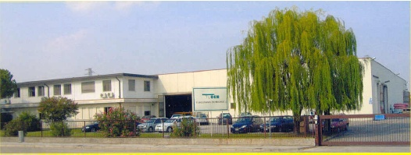

Material handling
and
dredging hoses

Slide 2
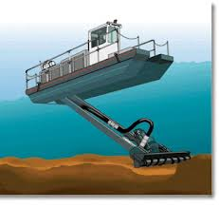
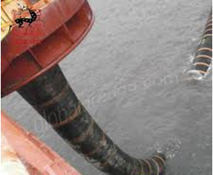
DREDGING OPERATIONS
The success of dredging operations depends on type and quality of delivery pipes and floaters that support the discharge line.
For a correct choice of a discharge or suction line, it is fundamental to know the working conditions and the material to be dredged.

Slide 3
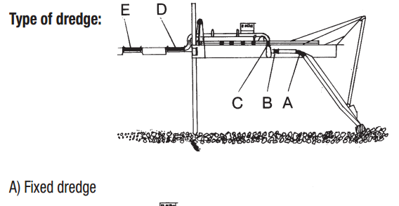
FLEXIBLE PIPES IN DREDGING APPLICATION
A- flexible hose hull connection
B- suction pump hose connection
C- discharging hose from the pump
D- joint between dredge and discharge line
E- discharge line

Slide 4
TUDERTECHNICA HOSES FOR DREDGING APPLICATION ARE USED AROUND BY MANY COMPANIES AND AMONG THEM:
    DRAGFLOW
    ITALDRAGHE
    DRAGHE LARIO
    SAIPEM
    ITALCEMENTI

Slide 5
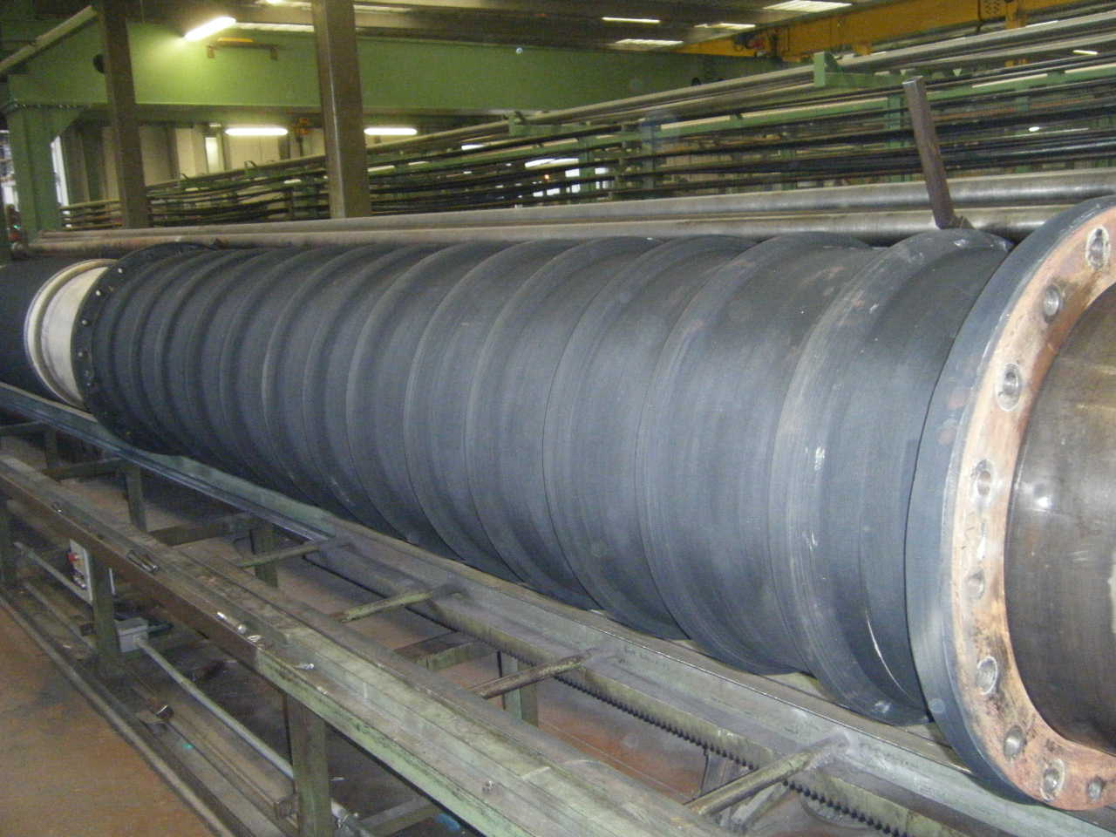
FLEXIBLE PIPES
Flexible pipes, are subjected to high abrasion and must guarantee the most handling versatility during dredging operations
HIGH ABRASION RESISTANCE
Produced in SERVICE LENGHTS
Can be manufactured with:
SOFT CUFFS
ENLARGED CUFFS
VULCANISED FLANGES
RUBBER PROTECTED FLANGES
BEADED ENDS
On request according to UNI EN ISO 28017

Slide 6
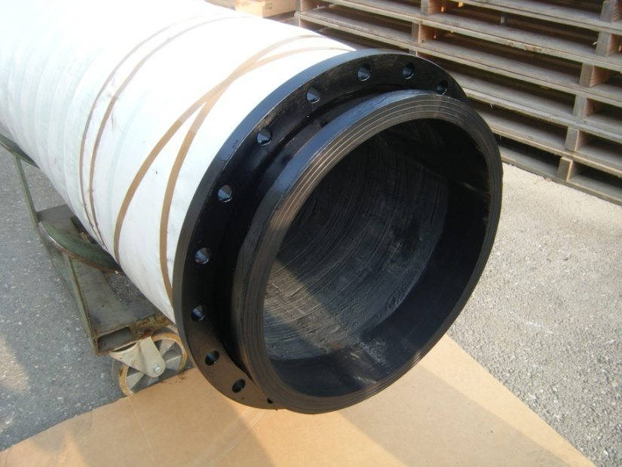
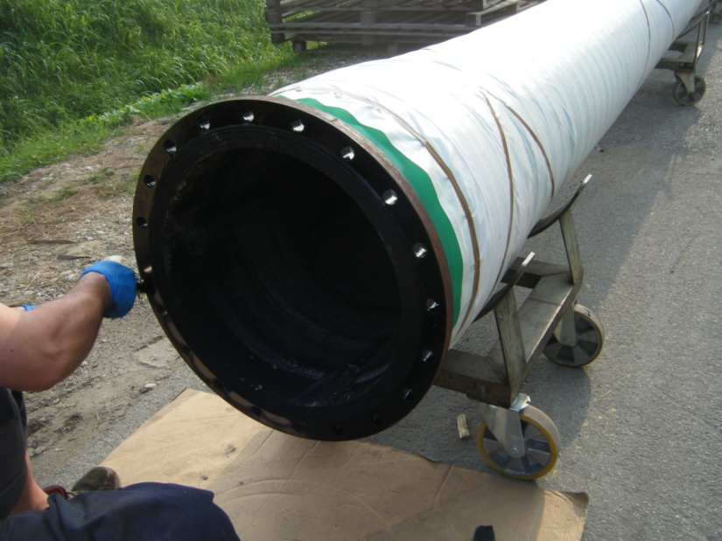
Hoses 20‘‘ ID Swivel flange
Hoses 20‘‘ ID fixed flange

Slide 7

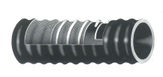
DRAGATELA
DISCHARGE hose suitable for the delivery of abrasive material mixed with water.
Used in the dredging system as connection between pump and suction pipe, discharging the material collected from the dredger.
DRAGABRASIVO A
Hose suitable for SUCTION of abrasive material mixed with water.
Especially used in the dredging system as connection between the suction pipes and pump.

Slide 8
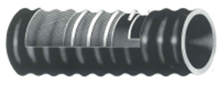
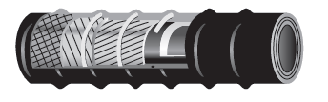
DRAGABRASIVO M
Hose suitable for SUCTION and DISCHARGE of abrasive material mixed with water.
Especially used in the dredging system as connection between the suction pipes and pump.
ANELLATO
Dredging hose used as the flexible connection between the vacuum pump and metal jib allowing the auger mechanism to operate on the sea bed.

Slide 9
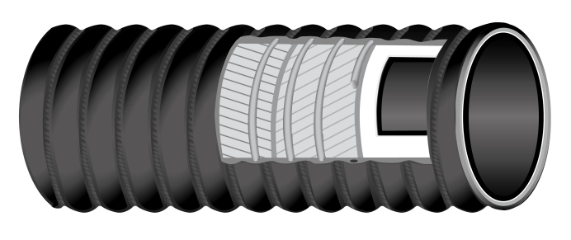

MARMOTECH™
Suction and delivery hose suitable for abrasive materials loke coal dust, sand, stone chips in dredging operations.
Can be assembled with reusable aluminium couplings system
TUBE: NR-SBR black, conductive, abrasion resistant
TECHNICAL CHARACTERISTICS
Temperature range -40°C/+70°C
DIAMETERS: from 1,5’’ to 16’’
Available also with
White food grade compound tube
Tan NR tube
Black EPDM tube
REINFORCEMENT: textile plies,
Steel wire helix; a/s copper wires to discharge static electricity on request
COVER: corrugated, CR, black, conductive, abrasion, ageing, ozone and oil resistant, cloth finish

Slide 10
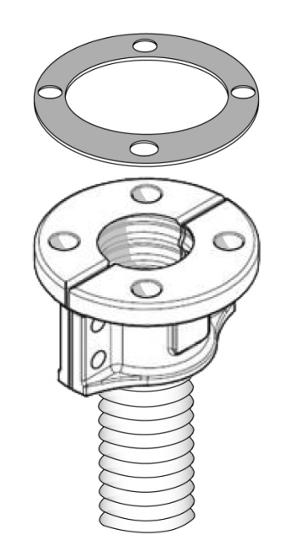
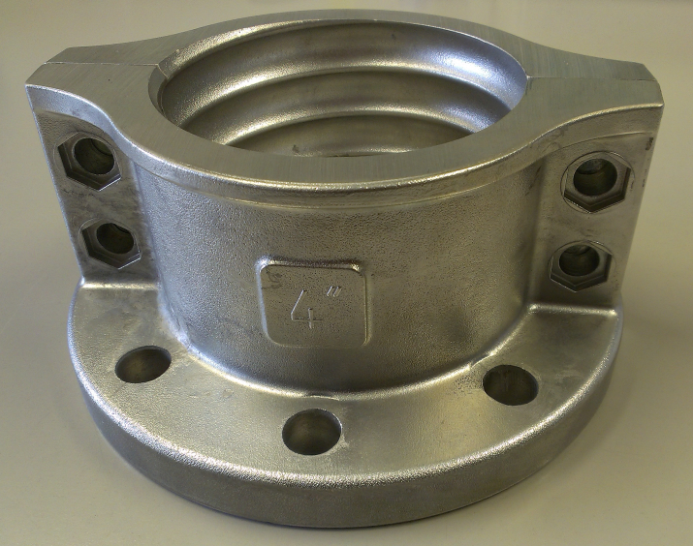
ALUMINUM COUPLINGS
Reusable aluminum coupling system, suitable to be fitted to MARMOTECH™ hose, including:
Aluminum semi-flanges according to UNI EN 1092-1 PN 10 (ex UNI 2277)
Flat black SBR gasket
Bolts, nuts and washers for the semi-flanges connection
Easy to handle and to install: special tools and trained personnel staff are not required.
Designed with self-blocking domed cup nuts to facilitate the semi-flanges connection.

