Slide 1

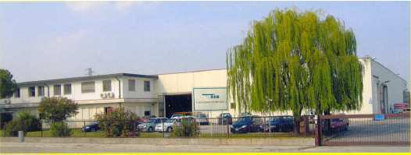
FOOD HOSES

Slide 2
FOOD HOSES
TUDERTECHNICA FOOD HOSES ARE USED AROUND THE WORLD BY MANY COMPANIES AND AMONG THEM:
    TETRAPACK
    INBEV
    DANONE
    CAMPBELLS
    PROGRESSO
    LACTALIS GROUP
    NESTLE’
    FERRERO
    COCA COLA
    KRAFT
    UNILEVER
    KNORR

Slide 3
TUDERTECHNICA
COMPETITIVE ADVANTAGES
Meets international food standards
Stainless steel mandrels (clean and smooth tube)
galvanized/stainless steel wire helices
superior oxidation resistance

Slide 4
TUDERTECHNICA
COMPETITIVE ADVANTAGES
Phthalates free tube, tested in compliance with 1907/2006/CE (REACH)
REPLACE PVC HOSES WHICH ARE NOT PHTHALATES FREE
Wide temperature range
replace pvc hoses
which crack in cold
temperature AND SOFTEN IN HOT TEMPERATURE
Robust textile construction
superior pressure resistance
LIGHT WEIGHT
VERY FLEXIBLE
EASY TO HANDLE
EASY TO OPERATE IN NARROW SPACE

Slide 5
FOOD HOSES - COMPARISON
HOSE TEMPERATURE RANGE
DIFFERENT TUBES
-25°C +80°C
NITRILE
-40°C +80°C
NR
-35°C +100°C
UPE
-40°C +120°C
BUTYL/EPDM
-40°C +150°C
Pfa/Ptfe

Slide 6
FOOD INDUSTRY TUBE COMPOUNDS
NR
WATER, WINE, VINIFICATION BY-PRODUCTS, FRUIT JUICE, MILK,
MILK BY-PRODUCTS, NON FATTY FOODS
NORMALLY USED IF HIGHER TEMPERATURE AND FREQUENT CLEANING AND STERILIZATION ARE REQUIRED NOT RECOMMENDED FOR FAT AND OIL
EPDM
PREMIUM GRADE, LOW PERMEATION, WINE, SPIRITS, BEER, ICE CREAM,
USED IF FREQUENT CLEANING AND STERILIZATION ARE REQUIRED
BUTYL
NITRILE
BUTTER, OIL, FATTY AND NON FATTY FOODS
DISTILLED AND DISTILLATION BY-PRODUCTS
WITH ALCOHOL CONCENTRATION UP TO 96%
UHMWPE
Pfa/Ptfe
WIDE RANGE OF FOOD PRODUCTS

Slide 7
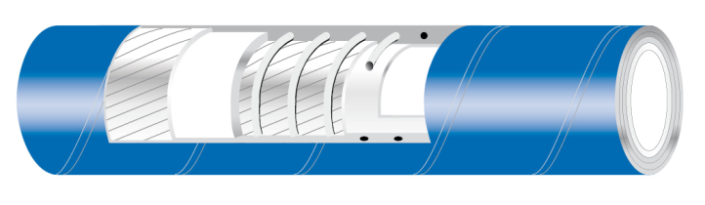









TUFOOD/FAT
Suction and delivery hose suitable for fatty and non fatty food products.
TUBE: NBR, white
  phthalates free, tested in compliance with 1907/2006/CE (REACH)
  FDA 21 CFR 177.2600
  BFR recommendation XXI cat 2
  DM 21.03.73 e seguenti
  EUROPEAN REGLEMENT 1935/2004/CE
  JAPAN-Ministry of Health and Welfare NoticE
  No.370,1959 and No.201, 2006
  3A SaNITARY STANDARD
  Ral registration G-73

Slide 8
TUFOOD/FAT
Suction and delivery hose suitable for fatty and non fatty food products.
REINFORCEMENT: synthetic plies - galvanized wire helices
COVER: smooth, red, abrasion, ageing and ozone resistant, cloth finish
WP: 10 BAR (150 PSI) BP: 30 BAR (450 PSI)
VACUUM: 675 mmHg (0,9 bar)
T: -25°C / +80°C ( -13°F / +176°F )

Slide 9
DAIRY HOSES
TUDERTECHNICA DAIRY HOSES ARE USED AROUND THE WORLD BY MANY COMPANIES AND AMONG THEM:
    FONTERRA (NEW ZEALAND)
    CMV , MURRAY GOULBURN (AUSTRALIA)
    CONAPROLE (URUGUAY)
    LA SERENISSIMA, SANCOR (ARGENTINA)
    MENGNIU, GUANGMING DAIRY, NESTLE’ (CHINA)
    LACTALIS GROUP (EUROPE)
    ALBERTSONS, DARIGOLD (USA)
    ALPINA (COLOMBIA)
    BR FOOD (BRAZIL)
    TETRAPAK (SWEDEN)

Slide 10
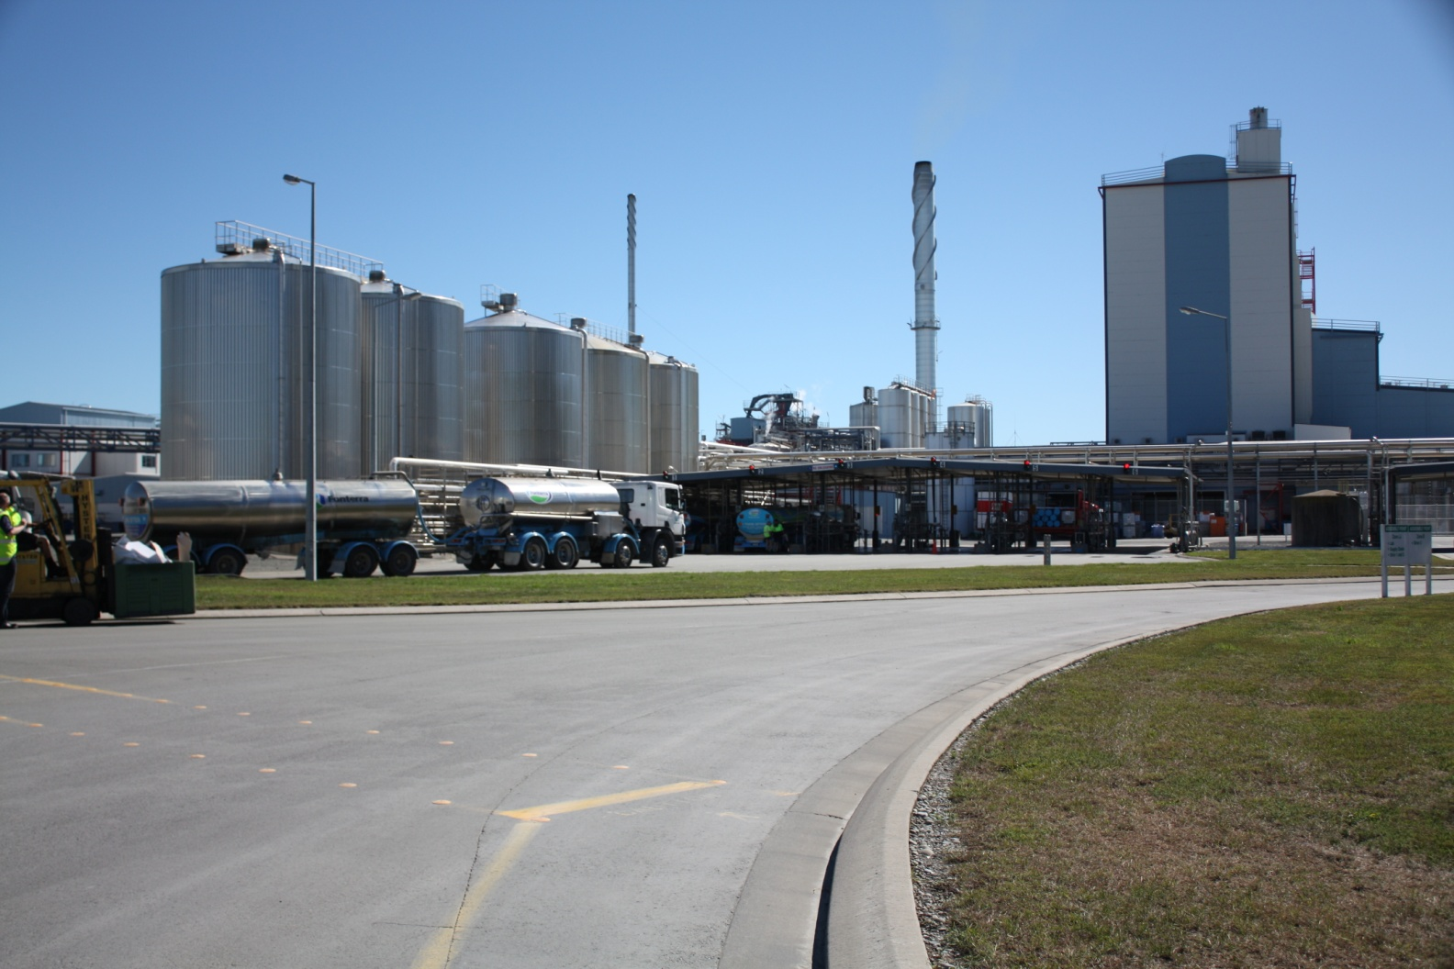
DAIRY HOSES

Slide 11
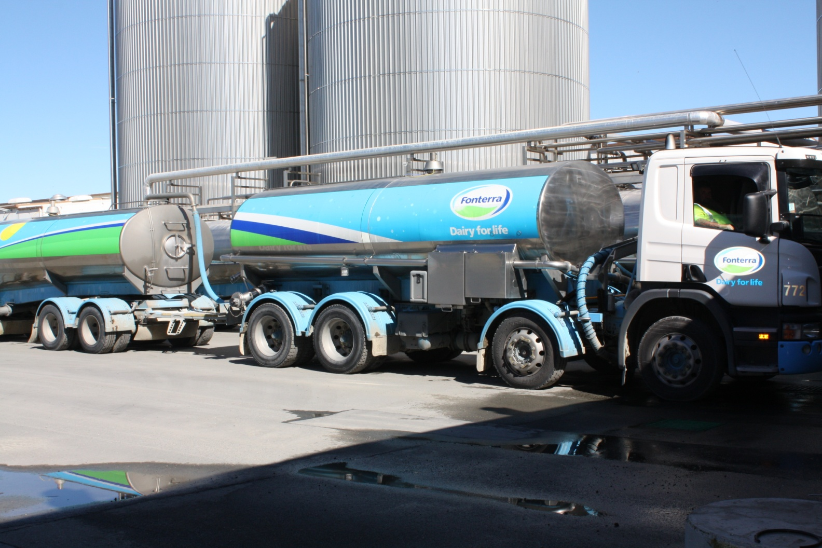
TRUCK

Slide 12
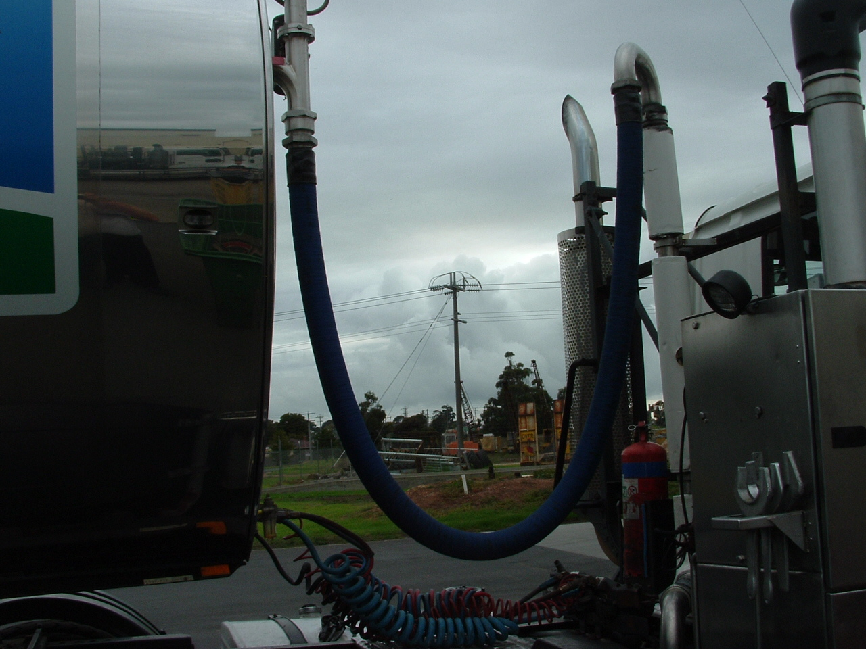
CONNECTION BETWEEN TANKS

Slide 13
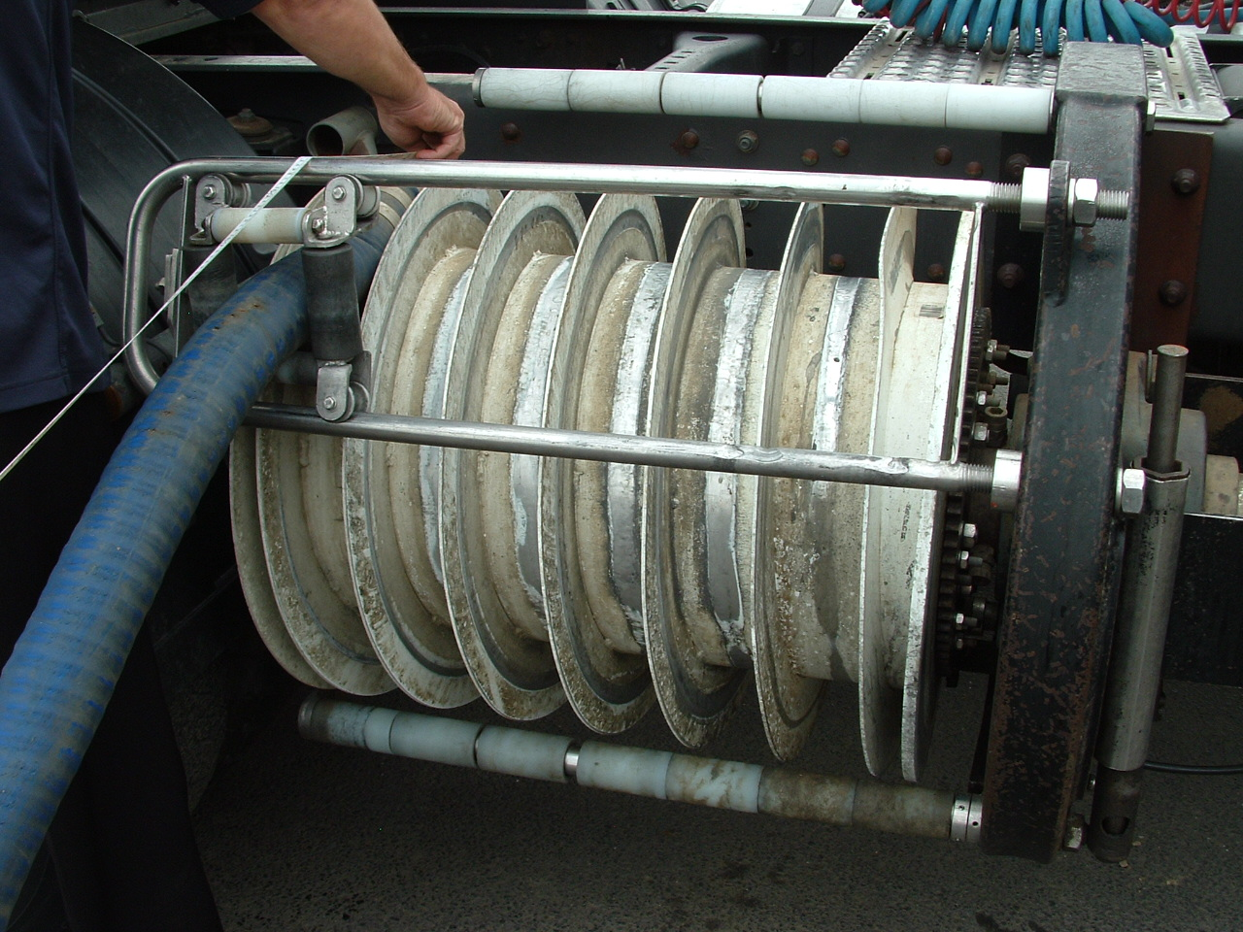
REELS

Slide 14
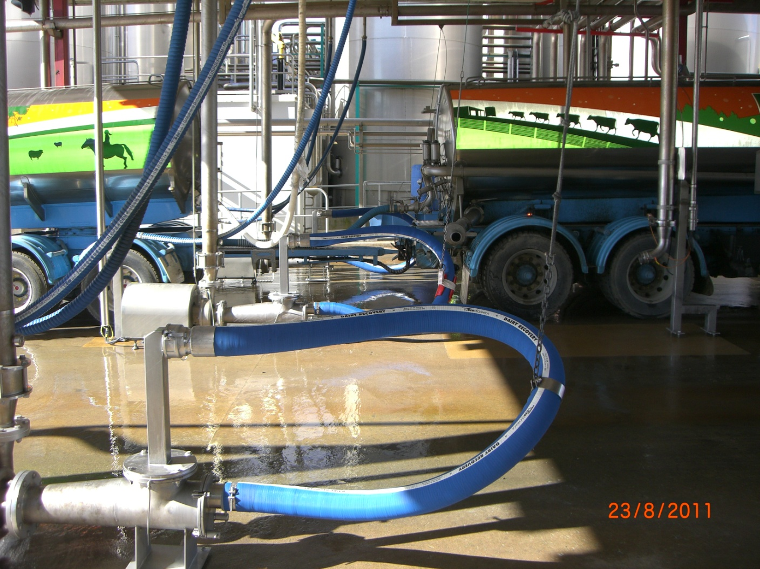
UNLOADING BAY

Slide 15
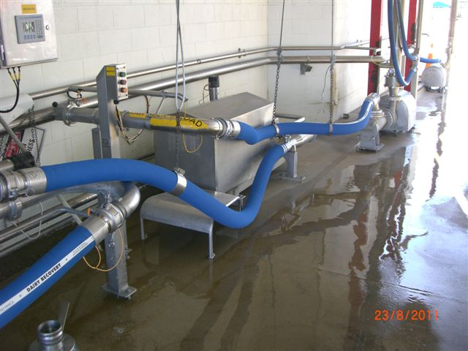
C.I.P. STATIONS

Slide 16
DAIRY HOSES
Lorry collecting hose for milk and milk by-products
MILKFLEX → Very light and flexible; WP 6 Bar
MILKFLEX PLUS → Very light and flexible; WP 10 Bar
MILKFLEX EXTRA LIGHT → EXTRA light and flexible; WP 6 Bar
MILKFLEX CRUSH RESISTANT → CRUSH RESISTANT; WP 6 Bar
GLIDETECH DAIRY → GLIDETECH; WP 10 Bar
TEMPERATURE RANGE: -40°C / +80°C ( -40°F / +176°F )
MAXIMUM VACUUM: 0,9 Bar (675mmHg)

Slide 17







DAIRY HOSES
FOOD GRADE TUBE: NR, white, complying with:
phthalates free, tested in compliance with 1907/2006/CE (REACH);
FDA 21 CFR 177.2600;
BFR recommendation XXI cat 2;
DM 21.03.73 e seguenti;
EUROPEAN REGLEMENT 1935/2004/CE;
JAPAN-Ministry of Health and Welfare Notice No.370,1959
and No.201, 2006;
Ral registration G-72

Slide 18


MILKFLEX
Light and flexible lorry collecting hose suitable for milk and milk by-products.
TUBE: NR, white
REINFORCEMENT: synthetic plies - galvanized wire helices
COVER: smooth, blue, abrasion, ageing and ozone resistant, cloth finish
WP: 6 BAR (90 PSI) BP: 18 BAR (270 PSI)
VACUUM: 675 mmHg (0,9 bar)
T: -40°C / +80°C ( -40°F / +176°F )
18

Slide 19
MILKFLEX PLUS
Light and flexible lorry collecting hose suitable for milk and milk by-products.
TUBE: NR, white
REINFORCEMENT: synthetic plies - galvanized wire helices
COVER: smooth, blue, abrasion, ageing and ozone resistant, cloth finish
WP: 10 BAR (150 PSI) BP: 30 BAR (450 PSI)
VACUUM: 675 mmHg (0,9 bar)
T: -40°C / +80°C ( -40°F / +176°F )
19

Slide 20

MILKFLEX EXTRA LIGHT
Extra light and flexible lorry collecting hose suitable for milk and milk by-products.
TUBE: NR, white
REINFORCEMENT: synthetic plies - galvanized wire helices
COVER: smooth, blue, abrasion, ageing and ozone resistant, cloth finish
WP: 6 BAR (90 PSI) BP: 18 BAR (270 PSI)
VACUUM: 675 mmHg (0,9 bar)
T: -40°C / +80°C ( -40°F / +176°F )
20

Slide 21
MILKFLEX CRUSH RESISTANT
Light and flexible lorry collecting hose suitable for milk and milk by-products. Crush resistant.
TUBE: NR, white
REINFORCEMENT: synthetic plies - thermoplastic wire helix
COVER: smooth, blue, abrasion, ageing and ozone resistant, cloth finish
WP: 6 BAR (90 PSI) BP: 18 BAR (270 PSI)
VACUUM: 525 mmHg (0,7 bar)
T: -40°C / +80°C ( -40°F / +176°F )
21

Slide 22
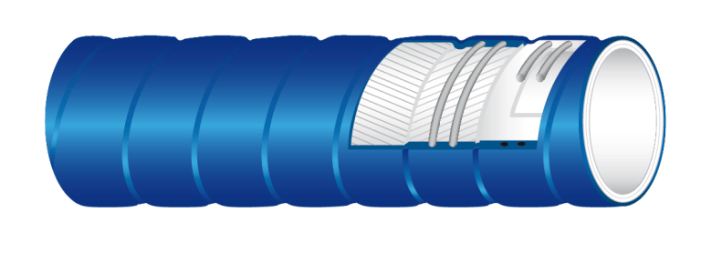

GLIDETECH® DAIRY
Extra flexible suction and delivery hose suitable for milk, milk by-products and non fatty food products.
TUBE: NR, white
REINFORCEMENT: synthetic plies - galvanized wire helices
COVER: GLIDETECH®, blue
WP: 10 BAR (150 PSI) BP: 30 BAR (450 PSI)
VACUUM: 675 mmHg (0,9 bar)
T: -40°C / +80°C ( -40°F / +176°F )
22

Slide 23
DAIRY HOSES SUMMARY
HOSE | TUBE | COVER | WP [bar] | BP [bar] | VACUUM [bar] | HELICES | WEIGHT [Kg/mt] ø51mm | BENDING RADIUS [mm] ø51mm
MILKFLEX | NR | Smooth | 6 | 18 | 0,9 | Galvanized steel | 1,54 | 150
MILKFLEX PLUS | NR | Smooth | 10 | 30 | 0,9 | Galvanized steel | 1,64 | 150
MILKFLEX EXTRA LIGHT | NR | Smooth | 6 | 18 | 0,9 | Galvanized steel | 1,37 | 150
MILKFLEX CRUSH RESISTANT | NR | Smooth | 6 | 18 | 0,7 | Thermoplastic | 1,45 | 185
GLIDETECH DAIRY | NR | Glidetech | 10 | 30 | 0,9 | Galvanized steel | 1,90 | 100

Slide 24
BREWERY HOSES
TUDERTECHNICA BREWERY HOSES ARE USED AROUND THE WORLD BY MANY COMPANIES AND AMONG THEM:
    MILLER-COORS (USA)
    INBEV (BRAZIL)
    HEINEKEN (EUROPE)
    ANHEISER BUSCH (USA)
    SAMUEL ADAMS (USA)
    TSINGTAO (CHINA)
    GOLDSTAR (ISRAEL)
    CERVECERIA QUILMES (ARGENTINA)
    KIRIN BRASIL (BRAZIL)
    TUI (NEW ZEALAND)

Slide 25
CLEANING AND DISINFECTION
IN BREWERY INDUSTRY
MICROBREWERY
NOT AUTOMATED BREWERY
AUTOMATED BREWERY
1- HOSE REMOVED FROM PRODUCTION LINE
C. I. P.
2- RINSING
3- CLEANING/DISINFECTING
4- RINSING

Slide 26
BREWERY HOSES
OFF LINE CLEANING METHOD
NOT AUTOMATED BREWERIES NEED FREQUENT CLEANING AND DISINFECTING PROCESS
PREMIUM GRADE LOW PERMEATION RUBBER COMPOUND
10 BAR WORKING PRESSURE CONSTRUCTION
FLEXIBILITY AND LIGHT WEIGHT

Slide 27
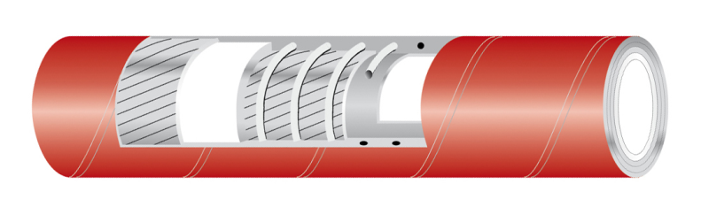


TUFOOD/EPDM
Suction and delivery hose suitable for a wide range of food products. Not recommended for fatty food products and oil.
TUBE: EPDM, white
  phthalates free, tested in compliance with 1907/2006/CE (REACH)
  FDA 21 CFR 177.2600
  BFR recommendation XXI cat 2
  DM 21.03.73 e seguenti
  EUROPEAN REGLEMENT 1935/2004/CE
  JAPAN-Ministry of Health and Welfare NoticE
  No.370,1959 and No.201, 2006
  3A SaNITARY STANDARD
  Ral registration G-74

Slide 28
TUFOOD/EPDM
Suction and delivery hose suitable for a wide range of food products. Not recommended for fatty food products and oil.
REINFORCEMENT: synthetic plies - galvanized wire helices
COVER: smooth, red, abrasion, ageing and ozone resistant, cloth finish
WP: 10 BAR (150 PSI) BP: 30 BAR (450 PSI)
VACUUM: 675 mmHg (0,9 bar)
T: -40°C / +120°C ( -40°F / +248°F )

Slide 29

TUPRESTIGE
Premium grade low permeation suction and delivery hose suitable for a wide range of products. Recommended for wine and spirits.
TUBE: IIR, white
  phthalates free, tested in compliance with 1907/2006/CE (REACH)
  FDA 21 CFR 177.2600
  DM 21.03.73 e seguenti
  EUROPEAN REGLEMENT 1935/2004/CE
  JAPAN-Ministry of Health and Welfare Notice
  No.370,1959 and No.201, 2006

Slide 30

TUPRESTIGE
Premium grade low permeation suction and delivery hose suitable for a wide range of products. Recommended for wine and spirits.
REINFORCEMENT: synthetic plies - galvanized wire helices
COVER: smooth, red, abrasion, ageing and ozone resistant, cloth finish
WP: 10 BAR (150 PSI) BP: 30 BAR (450 PSI)
VACUUM: 675 mmHg (0,9 bar)
T: -40°C / +120°C ( -40°F / +278°F )

Slide 31
BREWERY HOSES
CIP CLEANING METHOD
AUTOMATED BREWERIES NEED FREQUENT CLEANING AND DISINFECTING PROCESS
PREMIUM GRADE LOW PERMEATION RUBBER COMPOUND
ROBUST CONSTRUCTION WITH 16 BAR WORKING PRESSURE
FLEXIBILITY BUT HEAVY DUTY APPLICATION

Slide 32



BREWERY/EPDM
Suction and delivery hose suitable for beer and a wide range of non fatty food products with an improved resistance to higher pressure.
TUBE: EPDM, white
REINFORCEMENT: synthetic plies - galvanized wire helices
COVER: smooth, red, abrasion, ageing and ozone resistant, cloth finish
WP: 16 BAR (250 PSI) BP: 48 BAR (750 PSI)
VACUUM: 675 mmHg (0,9 bar)
T: -40°C / +120°C ( -40°F / +248°F )

Slide 33

BREWERY/BUTYL
Premium grade low permeation suction and delivery hose suitable for beer and a wide range of non fatty food products with an improved resistance to higher pressure.
TUBE: IIR, white
REINFORCEMENT: synthetic plies - galvanized wire helices
COVER: smooth, red, abrasion, ageing and ozone resistant, cloth finish
WP: 16 BAR (250 PSI) BP: 48 BAR (750 PSI)
VACUUM: 675 mmHg (0,9 bar)
T: -40°C / +120°C ( -40°F / +248°F )

Slide 34
CLEANING & SANITIZING
NOT ONLY HOSES SHOULD BE PROPERLY CLEANED AND SANITIZED
EQUIPMENT AND SYSTEMS USED TO PRODUCE, PROCESS AND PACKAGE FOOD, PHARMA AND COSMETIC MUST BE CLEANED AND SANITIZED TOO
FOOD APPROVED HOSES MUST BE USED FOR CLEANING EQUIPMENT AND SYSTEMS.

Slide 35
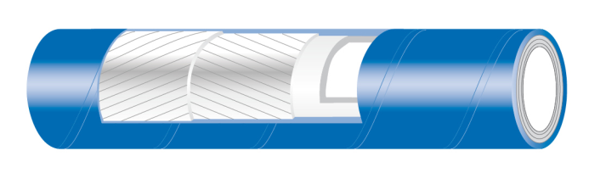

TUBLUESTREAM
Delivery hose suitable for a wide range of non fatty food products, recommended for cleaning plant and equipment with hot water mixed with steam.
TUBE: EPDM, white
REINFORCEMENT: synthetic plies
COVER: smooth, blue, abrasion, ageing, ozone and oil resistant, cloth finish
WP: 20 BAR (300 PSI) T: 95°C (+203°F) hot water
WP: 6 BAR (90 PSI) T:164°C (+327°F) STEAM

Slide 36




TUACQUA/KTW
Delivery hose suitable for potable water. Phthalates free tube, tested in compliance with 1907/2006/CE (REACH).
TUBE: UPE, translucent
  phthalates free, tested in compliance with 1907/2006/CE (REACH)
  FDA 21 CFR 177.1520
  BFR cat 3
  DM 21.03.73 e seguenti
  KTW class A
  W270
  EUROPEAN REGLEMENT 1935/2004/CE
  EUROPEAN REGLEMENT 10/2011/CE
  JAPAN-Ministry of Health and Welfare NoticE
  No.370,1959 and No.201, 2006

Slide 37
SILICONE HOSES
MAIN CHARACTERISTICS
Good long - term heat resistance at temperature up to 180°C (up to 220°C with special additives)
Excellent low temperature resistance, with retention of flexibility at – 50°C
Excellent ozone and uv resistant
odorless and tasteless
Outstanding electric properties (excellent insulation)
Low flammability (no products evolved, insulating silica dioxide remains)

Slide 38
SILICONE HOSES
MAIN CHARACTERISTICS
autoclavable (food)
sterilizable by gamma ray (pharma)
resistant to frequent cleaning and sterilization
complies with international food standards (tested after 100 sterilization cycles and still complying to FDA)
phthalates free tube, tested in compliance with 1907/2006/CE (REACH).

Slide 39
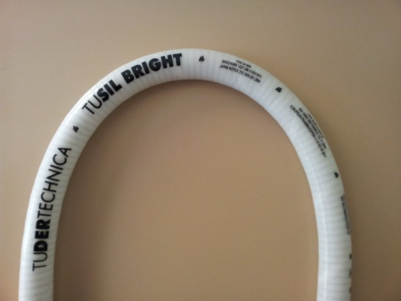







TUSIL BRIGHT
Suction and delivery hose suitable for cosmetic, pharmaceutical and food products. Phthalates free tube, tested in compliance with 1907/2006/CE (REACH). Tested in compliance with USP XXXII class VI, not cytotoxic according to ISO 10993 Section 5:2009. Meets migration test according to BfR Recommendation XV & XXI Cat. 2.
Temperature range -60°C / +200°C ( -76°F / +392°F )
Vacuum 675 mmHg ( 26,6 inHg )
Norm
FDA CFR 21 PART 177.2600,
USP XXXII class VI requirements,
European Pharmacopoeia 3.1.9 Ed. VII 2011,
ISO 10993 Section 5,10,11:2009
BfR Recommendation XV & xxi CAT. 2
European Reglement 1935/2004/CE
DM 21/03/1973 e seguenti,
JAPAN Ministry of Health and Welfare Notice No.370,1959 and No.201,2006 AND REVISION 2012
3A Sanitary Standard Class II

Slide 40
PRODUCT FEATURES - BENEFITS
40 MT LENGHT
REDUCES SHORT LENGTHS :
WASTE REDUCTION
SILICONE TUBE TESTED IN COMPLIANCE WITH USP XXXII CLASS VI
ODORLESS AND TASTELESS
HIGHER PURITY AND SAFETY
SILICONE TUBE MEETS BfR RECOMMENDATION XV MIGRATION TESTS (24H 80°C) WITH:
  AQUEOUS
ACIDIC
ALCOHOLIC
FATTY FOODSTUFFS
MILK AND DAIRY PRODUCTS

Slide 41
SPECIALTY PRODUCTS
DRY FOOD HOSES
CEREALS, RICE, GRAIN, SEEDS, …
ABRASION RESISTANCE HIGHER THAN STANDARD NATURAL RUBBER COMPOUND

Slide 42
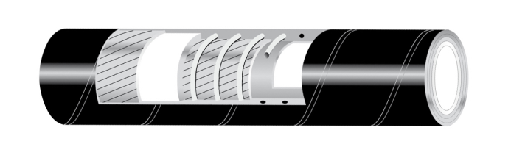
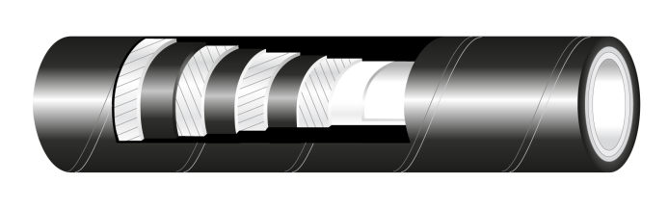
DRY FOOD HOSES
DRYFOOD
ANTISTATIC
DRY FOOD
ANTISTATIC D
POWDERY AND GRANULAR DRY FOOD PRODUCTS
ANTISTATIC NBR WHITE TUBE (R<10⁸ Ω/m)
MEETS FDA AND BfR CAT IV

Slide 43


DRYFOOD ANTISTATIC
Suction and delivery hose with white antistatic tube suitable for powdery and granular dry food products.
Tube: NBR, white, antistatic (R<10⁸ Ω/m). Meets FDA 21 CFR 177.2600, BFR recommendation XXI cat 4
Reinforcement : synthetic plies, galvanized wire helices
Cover: smooth, black, conductive, abrasion, ageing and ozone resistant, cloth finish

Slide 44
DRYFOOD ANTISTATIC D
Delivery hose with white antistatic tube suitable for powdery and granular dry food products.
Tube: NBR, white, antistatic (R<10⁸ Ω/m). Meets FDA 21 CFR 177.2600, BFR recommendation XXI cat 4
Reinforcement : synthetic plies
Cover: smooth, black, conductive, abrasion, ageing and ozone resistant, cloth finish

