Slide 1

CRUSH RESISTANT HOSE
SUCTION and DELIVERY

Slide 2
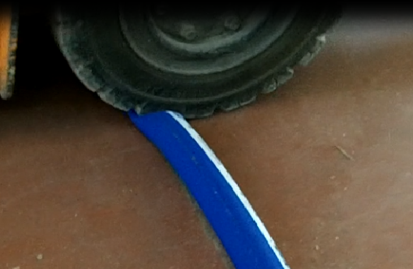
CRUSH RESISTANT HOSE
THERMOPLASTIC WIRE
THE HOSE IS COMPRESSED BY AN EXTERNAL AGENT :
TRUCK WHEEL, OTHER HOSES, EXTERNAL WEIGHT
WHEN THE EXTERNAL OVERWEIGHT ON THE SURFACE OF THE HOSE IS REMOVED THE HOSE RECOVERS ITS ORIGINAL SHAPE

Slide 3
BENEFITS OF THE CRUSH RESISTANCE
1 – THE HOSE RECOVERS ITS ORIGINAL SHAPE
2 - LOWER WEIGHT COMPARED TO STANDARD STEEL HELIX REINFORCED HOSES
3 - GOOD FLEXIBILITY

Slide 4
CRUSH RESISTANT TECHNOLOGY
Different constructions
WORKING PRESSURE
WEIGHT
BENDING RADIUS
Customized tube compounds
NR
NBR
EPDM
BUTYL
SILICONE
Wide range of applications
CHEMICAL and PETROL
FOOD
ABRASIVE
Customized covers
DIFFERENT COLOURS

Slide 5
CRUSH RESISTANT HOSES
HOSE | TUBE | WP [bar] | BP [bar] | VACUUM [bar] | HELICES | BENDING RADIUS [mm] ø51mm
MILKFLEX | NR | 6 | 18 | 0,7 | Thermoplastic | 185
TUFOOD/NATURAL | NR | 10 | 30 | 0,7 | Thermoplastic | 240
TUFOOD/FAT | NBR | 10 | 30 | 0,7 | Thermoplastic | 240
TUFOOD/EPDM | EPDM | 10 | 30 | 0,7 | Thermoplastic | 240
TUPRESTIGE | IIR | 10 | 30 | 0,7 | Thermoplastic | 240

Slide 6
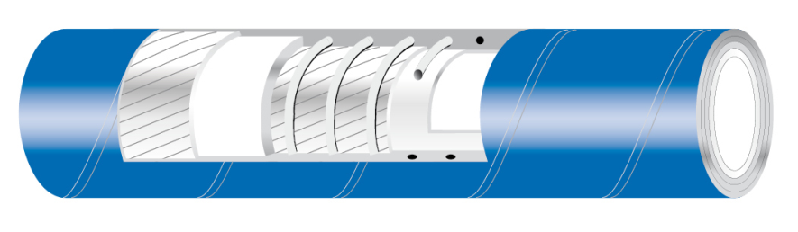
MILKFLEX/CRUSH RESISTANT
Light and flexible lorry collecting hose suitable for milk and milk by-products. Crush resistant.
TUBE: NR, white
    phthalates free, tested in compliance with REACH regulation
    FDA 21 CFR 177.2600
    BFR recommendation XXI cat 2
    DM 21.03.73 e seguenti
    EUROPEAN REGLEMENT 1935/2004/CE
    JAPAN-Ministry of Health and Welfare Notice No.370,1959 and No.201, 2006
    Ral registration G-72

Slide 7
MILKFLEX/CRUSH RESISTANT
Light and flexible lorry collecting hose suitable for milk and milk by-products. Crush resistant.
REINFORCEMENT: synthetic plies - thermoplastic wire helix
COVER: smooth, blue, abrasion, ageing and ozone resistant, cloth finish
WP: 6 BAR (90 PSI) BP: 18 BAR (270 PSI)
VACUUM: 525 mmHg (0,7 bar)
T: -40°C / +80°C ( -40°F / +176°F )

