Slide 1
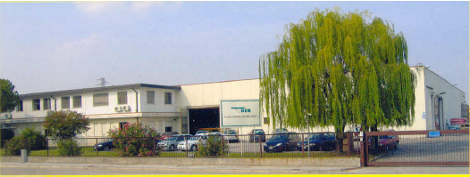
STEELMILLS

Slide 2
MAIN APPLICATIONS
INDUSTRIAL WATER
CABLE PROTECTION
CABLE COOLING
OXYGEN DELIVERY
CARBON INJECTION
FURNACE COOLING

Slide 3
CABLE PROTECTION - COOLING
DELIVERY HOSES WITH:
INSULATING RUBBER (EPDM BLACK/WHITE)
TEMPERATURE RANGE : -40°C / +120°C
WORKING PRESSURE 20/25 BAR
ADDITIONAL PROTECTION ON THE COVER (ONE OR MORE)
FIBER GLASS RESISTANT MAX 550°C
SILICATE RESISTANT MAX 800°C
ADDITIONAL RUBBER FLAME RESISTANT (ON REQUEST)
NORMALLY WITH SWAGED COUPLINGS

Slide 4
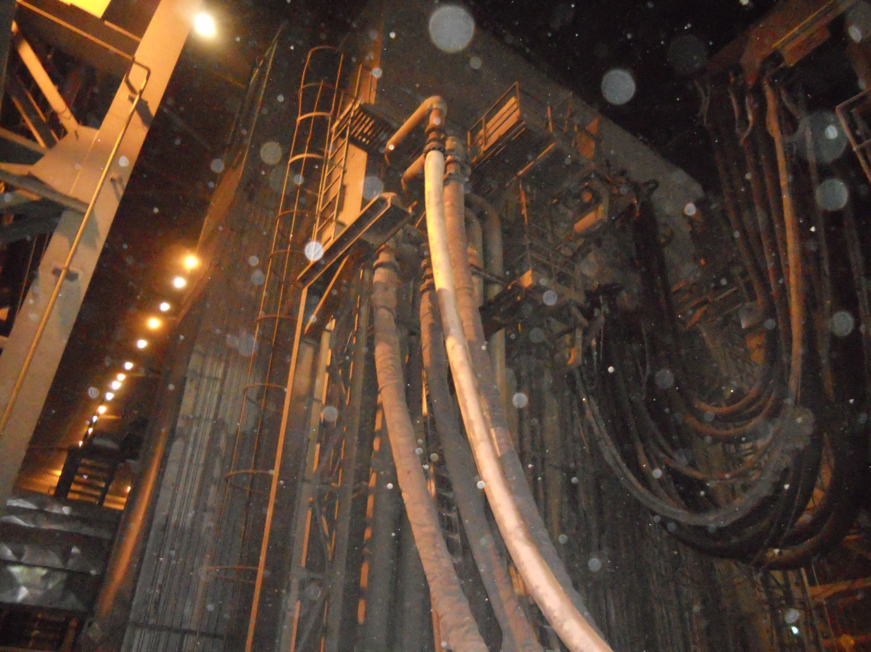

Slide 5
OXYGEN DELIVERY
WORKING PRESSURE 20 - 40 BAR
NORMALLY CR RUBBER FLAME RESISTANT
NORMALLY SMALL DIAMETERS (13-51MM)
ON REQUEST WITH ADDITIONAL COVER PROTECTION
LARGE DIAMETERS (4’’ – 10’’) NORMALLY WITH HELIX:
INSULATING
VX COVER
BUILT – IN AISI COUPLINGS

Slide 6
CARBON INJECTION
THE SITUATION
HIGHLY ABRASIVE CARBON BLACK IS INJECTED WITH COMPRESSOR AIR THROUGH HOSES INTO ELECTRIC ARC FURNACES TO HELP REGULATE THE CHEMISTRY AND TEMPERATURE OF THE MOLTEN STEEL.
TUDERTECHNICA SOLUTION
TUSILO PU OND STRAIGHT-THROUGH DESIGN ATTACHEMENT HELP MINIMIZE FLOW RESTRICTIONS AND ABRASION FAILURES, KEEPING THE FURNACES IN OPERATION LONGER BETWEEN SCHEDULED MAINTENANCE EVENTS.

Slide 7
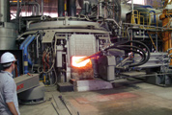
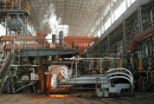
CARBON INJECTION

Slide 8
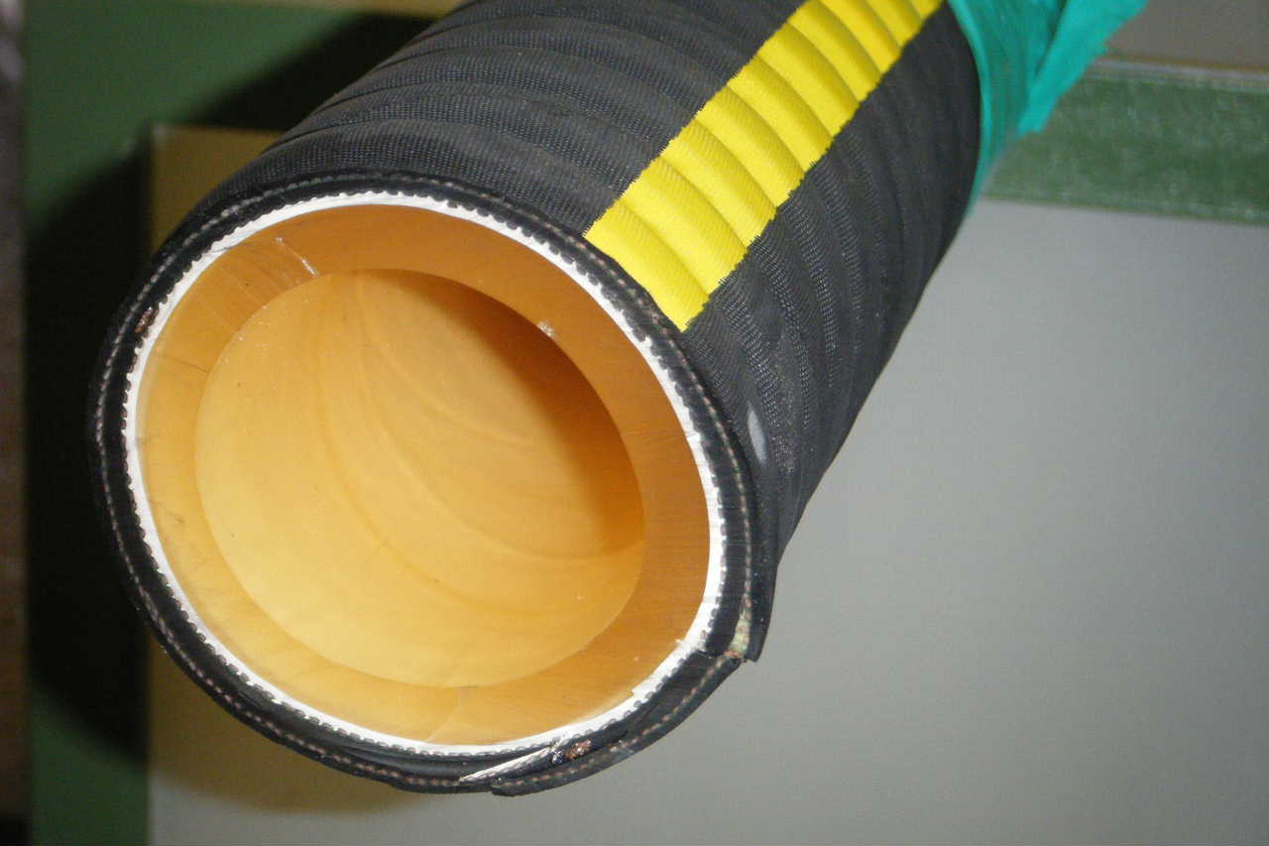
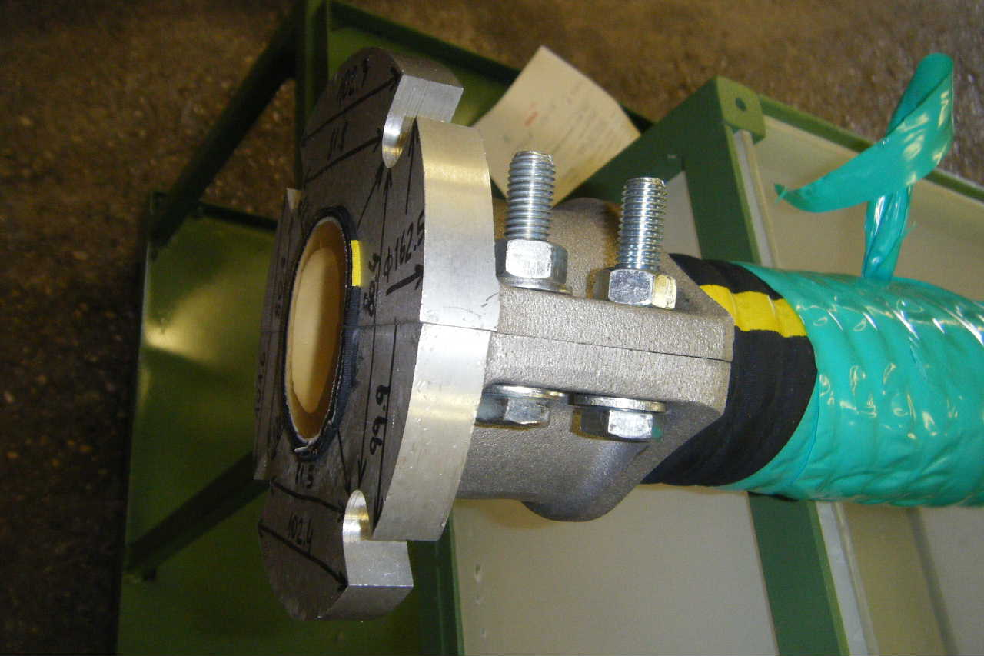
STEELBLAST
PARTICULARLY SUITABLE FOR ABRASIVE BULK MATERIAL (AIR/WATER FLUIDIZATION OF GLASS, SAND, STONE CHIPS, COAL DUST)

Slide 9
STEEL BLAST COMPARED TO CERAMIC Tube Hose
FEATURES | TUDERTECHNICA/ TUSILO PU OND | CERAMIC TUBE
BENDING RADIUS – DN 102 | 510 mm | 1500 mm
WEIGHT DN 102 | 3.01 Kg/mt | 8,56 Kg/mt
Cover Flame resistance | Good (CR compound) | No (SBR compound)
Tube Oil resistance | Good | No resistant
Tube service life | Factor of 1 | 4 time higher
Hose service life | Factor of 1 | Sometime equal : depends strongly by contact medium or external environment
Delivery time | 2 / 3 weeks or less | 6 / 8 weeks
Minimum Order Quantity | No | Yes
Market Price | Factor of 1 | 5/6 Time higher

Slide 10
TUDERTECHNICA VALUE ADVANTAGES
COST EFFECTIVENESS
THE COST OF POLYURETHANE HOSES IS MUCH LOWER THAN ANY CERAMIC TUBE HOSE (ABOUT 3–5 TIMES LESS THAN PRICE IN THE EUROPEAN MARKET). IN THIS WAY ALSO THE COST OF INVENTORY IS REDUCED.
REUSABLE COUPLINGS
WHEN THE HOSE BREAKS, THE CUSTOMER CHANGES THE HOSE BUT KEEPS THE ALUMINUM FLANGES. THIS IS VERY IMPORTANT BECAUSE WITH THE SOLUTION USED TODAY THE CUSTOMER THROWS AWAY THE HOSE AND THE FLANGES TOGETHER.

Slide 11
TUDERTECHNICA VALUE ADVANTAGES
ABRASION RESISTANCE
THE POLYURETHANE HAS SUPERIOR ABRASION RESISTANCE THAN TRADITIONAL RUBBER.
THE ABRASION LOSS MEASURED IS 26MM³ (4 TIMES LOWER THAN TRADITIONAL COMPOUNDS).
IN COMPARISON WITH STANDARD SAND BLASTING HOSES THE LIFE IS 6-8 TIMES HIGHER.
TUBE WITH LOW FRICTION RATE
THE FLOW OF MATERIAL IS FACILITATED
(REDUCED TIME FOR UNLOADING PROCESS).

Slide 12
TUDERTECHNICA VALUE ADVANTAGES
GOOD BENDING RADIUS
THE BENDING RADIUS IS SUPERIOR COMPARED TO CERAMIC TUBE HOSES.
FLAME RESISTANT COVER
INCREASED SAFETY FOR BOTH OPERATORS AND EQUIPMENT.

Slide 13
TUDERTECHNICA VALUE ADVANTAGES
CUSTOMIZED COVER
DIFFERENT COVER STYLES ARE AVAILABLE. THE SHAPE CAN BE SMOOTH, CORRUGATED OR WIDE CORRUGATED.
AVAILABLE ALSO WITH GLASS FIBER OUTSIDE FOR PROTECTION AGAINST HEAT AND MELTING DROPS OR WITH GLASS FIBER AND SILICONE COVER FOR PROTECTION FROM ABRASION AND DISPERSION OF MICRO-FIBERS.
OPTIMIZATION OF HOSE CONSTRUCTION
THE HOSE DESIGN IS THE PROPER BALANCE BETWEEN PERFORMANCE OF TUBE AND COVER. NORMALLY THE CERAMIC TUBE HOSE IS CHANGED BECAUSE OF A FAILURE OF THE COVER DURING OPERATION.

Slide 14
TUDERTECHNICA VALUE ADVANTAGES
QUICKER DELIVERY TIME
POLYURETHANE HOSES DO NOT REQUIRE SET UP OF MANUFACTURER’S PRODUCTION EQUIPMENT.
WIDE RANGE OF DIAMETERS
INSIDE DIAMETER FROM 10 MM TO 508 MM.
LENGHT 40 MT UP TO 102 MM INSIDE DIAMETER, 12 MT UP TO 508 MM INSIDE DIAMETER.

Slide 15
TUDERTECHNICA
VALUE ADVANTAGES
REUSABLE COUPLINGS
TUBE ABRASION RESISTANT
TUBE WITH LOW FRICTION RATE
GOOD BENDING RADIUS
FLAME RESISTANT COVER
CUSTOMIZED COVER
OPTIMIZATION OF HOSE CONSTRUCTION
QUICKER DELIVERY TIME
WIDE RANGE OF DIAMETERS
COST EFFECTIVENESS

Slide 16
BENEFITS
ABRASION RESISTANCE
HIGHER THAN STANDARD NATURAL RUBBER COMPOUND 26MM3 (4 TIMES LOWER THAN TRADITIONAL COMPOUNDS)
TEMPERATURE

