Slide 1
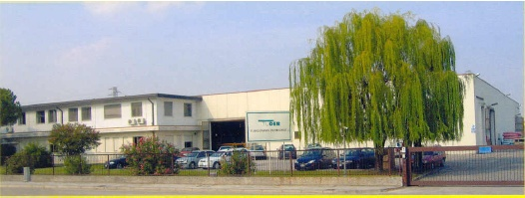

MATERIAL HANDLING:
MARMOTECH

Slide 2
APPLICATIONS
STEEL INDUSTRY
FOOD INDUSTRY: CEREALS, RICE, GRAIN, SEEDS, FLOUR, SUGAR
PLASTIC INDUSTRY: PVC, PE, POWDERS
CERAMIC INDUSTRY: CARBONATE POWDER

Slide 3
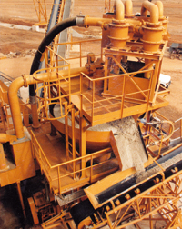
MARMOTECH ™
MARMOTECH APPLICATION
Flexible line for conveying abrasive material (particularly suitable in the context of hydrocyclones)

Slide 4
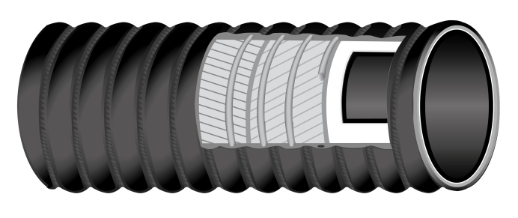

MARMOTECH ™
Suction and delivery hose suitable for abrasive materials loke coal dust, sand, stone chips in dredging operations.
Can be assembled with reusable aluminium couplings system
TUBE: NR-SBR black, conductive, abrasion resistant
TECHNICAL CHARACTERISTICS
Temperature range -40°C/+70°C
DIAMETERS: from 1,5’’ to 16’’
Available also with
White food grade compound tube
Tan NR tube
Black EPDM tube
REINFORCEMENT: textile plies,
Steel wire helix; a/s copper wires to discharge static electricity on request
COVER: corrugated, CR, black, conductive, abrasion, ageing, ozone and oil resistant, cloth finish

Slide 5
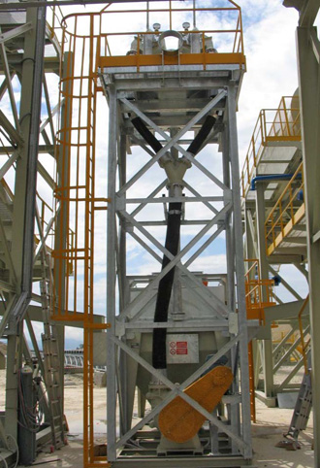
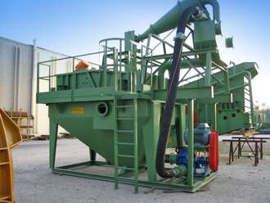
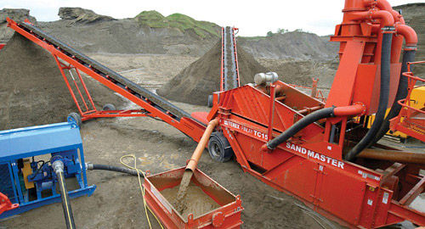
MARMOTECH BENEFITS
Easy installation
Flexibility
Resistance
Adaptability
Availability
(range from ID 38 mm to ID 404 mm)

Slide 6
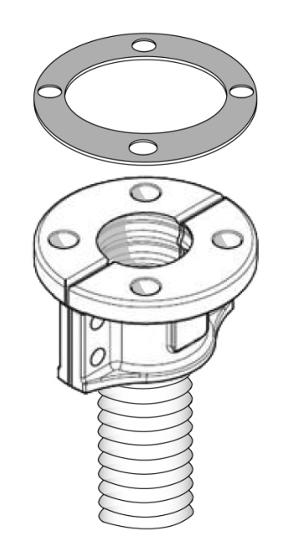
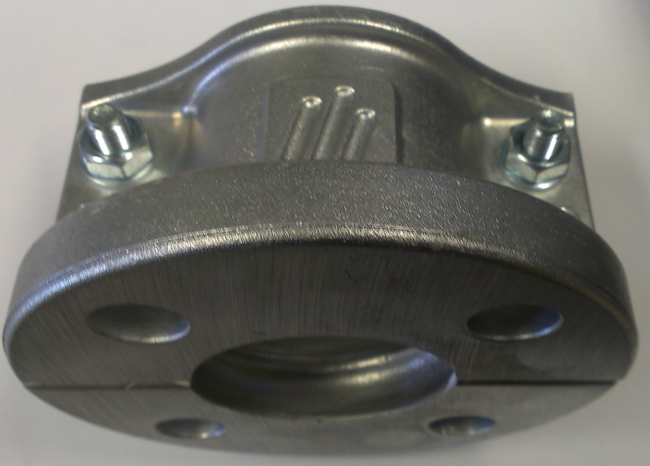
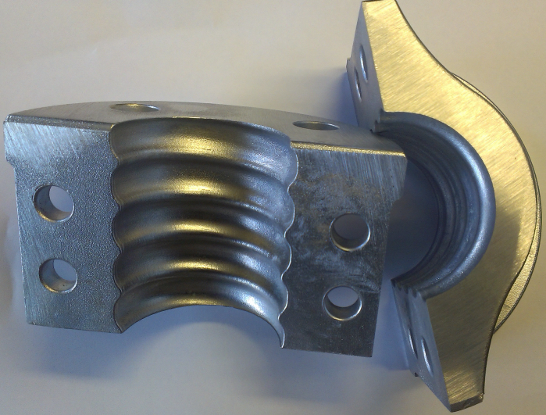
ALUMINUM COUPLINGS
Easy to install
Reusable
Light weight (aluminum)

