Slide 1

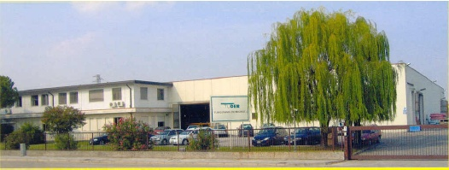
PETROL AND
CHEMICAL HOSES

Slide 2
INDUSTRY SUBDIVISION
PETROL INDUSTRY:
  OIL RIGS AND EXTRACTION POINTS
  TRANSPORTATION TO THE PORT (DOCK HOSE)
  REFINERY
  TRANSPORTATION TO STATION/INDUSTRY
  CHEMICAL INDUSTRY:
  CHEMICAL PLANT
  TRANSPORTATION TO AND FROM THE PLANT

Slide 3
PETROL INDUSTRY
INSIDE THE PLANT:
  PETROL AND PETROL DERIVATES
  CHEMICALS
  TRANSPORTATION:
    TRUCKS
CHEMICAL INDUSTRY
INSIDE THE PLANT:
  SOLVENTS, ACIDS, FLUIDS
  CHEMICALS
  TRANSPORTATION:
    TRUCKS

Slide 4
ATEX ZONES
EXPLOSIVE ATMOSPHERES CAN BE CAUSED BY FLAMMABLE GASES, MISTS OR VAPOURS OR BY COMBUSTIBLE DUSTS. IF THERE IS ENOUGH OF THE SUBSTANCE, MIXED WITH AIR, THEN ALL IT NEEDS IS A SOURCE OF IGNITION TO CAUSE AN EXPLOSION
EXPLOSIONS CAN CAUSE DEATH AND SERIOUS INJURIES AS WELL AS SIGNIFICANT DAMAGE. PREVENTING RELEASES OF DANGEROUS SUBSTANCES, WHICH CAN CREATE EXPLOSIVE ATMOSPHERES, AND PREVENTING SOURCES OF IGNITION ARE TWO WIDELY USED WAYS OF REDUCING THE RISK. USING THE CORRECT EQUIPMENT CAN HELP GREATLY IN THIS.

Slide 5
ATEX ZONES
PURPOSE
ATEX IS THE NAME COMMONLY GIVEN TO THE TWO EUROPEAN DIRECTIVES FOR CONTROLLING EXPLOSIVE ATMOSPHERES.
THE MAIN PURPOSE OF THE ATEX DIRECTIVE IS TO MINIMIZE, OR COMPLETELY ELIMINATE, THE RISK OF IGNITION IN EXPLOSIVE AREAS AND TO LIMIT THE HARMFUL EFFECTS IN CASE OF AN EXPLOSION.

Slide 6
ATEX ZONES
DEFINITION
THE HAZARDOUS PLACES ARE CLASSIFIED INTO ZONES BASED ON THE FREQUENCY AND DURATION OF A HAZARDOUS EXPLOSIVE ATMOSPHERE:
Zone 0 | Area in which an explosive gas/vapor atmosphere is present continuously or for long periods or frequently, (e.g.1000 hours or more per year).
Zone 1 | Area in which an explosive gas atmosphere is likely to occur in normal operation occasionally, (e.g. 10-1000 hours/year).
Zone 2 | Area in which an explosive gas atmosphere is not likely to occur in normal operation and if it does occur, is likely to do so only infrequently and will exist for a short period only, (e.g. less than 10 hours/year).
THE SAME CRITERIA FOR COMBUSTIBLE DUSTS : ZONE 20, 21, 22

Slide 7
ATEX ZONES
IN USA AND CANADA
THE EUROPEAN ATEX ZONE CLASSIFICATION CONVERTED TO US, CANADIAN AND INTERNATIONAL STANDARDS:
Europe | Canada* and USA** | IEC (International)
Zone 0 | Class I Division I | Zone 0
Zone 1 | Class I Division I | Zone 1
Zone 2 | Class I Division II | Zone 2
*Canada CEC (Canadian Electricity Code)
** USA NEC (National Electric Code)

Slide 8
I.E.C. CLASSIFICATION
CLASS I FLAMMABLE GASES, VAPOURS OR LIQUIDS |  | CLASS II COMBUSTIBLE DUSTS
DIVISION SYSTEM | ZONE SYSTEM
 | ZONE 0 IGNITABLE CONCENTRATIONS OF GASES, VAPOURS, OR LIQUIDS ARE CONTINUOUSLY PRESENT UNDER NORMAL OPERATING CONDITIONS
DIVISION 1 IGNITABLE CONCENTRATIONS OF GASES, VAPOURS, OR LIQUIDS MAY BE PRESENT UNDER NORMAL OPERATING CONDITIONS | ZONE 1 IGNITABLE CONCENTRATIONS OF GASES, VAPOURS, OR LIQUIDS MAY BE PRESENT UNDER NORMAL OPERATING CONDITIONS | DIVISION 1 IGNITABLE CONCENTRATIONS OF COMBUSTIBLE DUSTS MAY BE PRESENT UNDER NORMAL OPERATING CONDITIONS
DIVISION 2 IGNITABLE CONCENTRATIONS OF GASES, VAPOURS, OR LIQUIDS ARE NOT LIKELY PRESENT UNDER NORMAL OPERATING CONDITIONS | ZONE 2 IGNITABLE CONCENTRATIONS OF GASES, VAPOURS, OR LIQUIDS ARE NOT LIKELY PRESENT UNDER NORMAL OPERATING CONDITIONS | DIVISION 2 IGNITABLE CONCENTRATIONS OF COMBUSTIBLE DUSTS ARE NOT LIKELY PRESENT UNDER NORMAL OPERATING CONDITIONS
CLASS I GROUPS DIVISION 1 AND 2: A (ACETYLENE) B (HYDROGEN) C (ETHYLENE) D (PROPANE) | CLASS I GROUPS ZONE 0, 1 AND 2 IIC (ACETYLENE AND HYDROGEN) IIB (ETHYLENE) IIA (PROPANE) | CLASS II GROUPS DIVISION 1 AND 2: E (METAL DUSTS) F (COAL) G (GRAIN)

Slide 9
TUDERTECHNICA HOSES
MAIN CHARACTERISTICS
Designed according to EN12115 standard (one of the most stringent norms used for the design and production of chemical hoses)
Tested and certified by INERIS for use in Atex area (Ex-Zone)
Galvanized (Zinc coated) or stainless steel wire helices, superior oxidation resistance
Robust textile construction, superior pressure resistance
Accurate choice of materials
Flammability testED
ElectricalLY conductive

Slide 10
DESIGN ACCORDING TO EN 12115: WHY?
IT IS ONE OF THE MOST STRINGENT NORMS USED FOR THE DESIGN AND PRODUCTION OF CHEMICAL HOSES TO ENSURE THAT:
USERS ARE NOT EXPOSED TO DANGER FROM FIRE OR EXPLOSION
THE ENVIRONMENT IS PROTECTED AGAINST CONTAMINATION OR DAMAGED

Slide 11
DESIGN ACCORDING TO EN 12115
MAIN FEATURES
Accurate choice of materials ACCORDING TO THE STANDARD SPECIFICATIONS
ROBUST CONSTRUCTION (safety factor 4:1)
OZONE RESISTANCE
FLAMMABILITY TEST
ELECTRICAL PROPERTIES

Slide 12
DESIGN ACCORDING TO EN 12115 ELECTRICAL PROPERTIES
The CONDUCTIVITY is an important feature FOR the choice of the most appropriate product for the application
Chemical hoses are potentially used in atmosphere where THE degree of risk for explosion IS HIGH
THE HOSES ARE DESIGNED TO ENSURE THE FOLLOWING CONDUCTIVE VALUES:
Along the bonding wires: M (R<10² Ω)
Along the conductive layer (tube/cover): Ω (R<10⁶ Ω)
Through the hose wall: Ω /T (R<10⁹ Ω)

Slide 13
NBR
features
CHARACTERISTICS : Excellent resistance to oils
OPERATING TEMPERATURE: -30 to +100 ° C
CHEMICAL RESISTANCE: mineral and vegetable oils, usually used for gasoline, diesel fuel. resistant to hydrocarbons with aromatic content up to 50%.

Slide 14

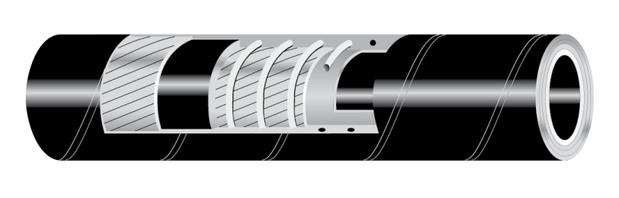

TUPETROL MASTER
Suction and delivery hose designed according to EN 12115 standards for oil and petrol, aromatic content up to 50%.
TESTED AND CERTIFIED BY INERIS FOR USE IN ATEX AREA (EX-ZONE 0, 1 and 2)
TUBE: NBR 1, black, conductive
REINFORCEMENT: synthetic plies - a/s copper wire to discharge static electricity - galvanized wire helices
COVER: smooth, CR, black, conductive, abrasion, ageing, ozone and oil resistant, cloth finish
WP: 16 BAR (250 PSI) BP: 64 BAR (1000 PSI)
VACUUM: 675 mmHg (0,9 bar)
T: -30°C / +100°C ( -22°F / +212°F )

Slide 15
TUPETROL MASTER vs STANDARD OIL
SUCTION AND DISCHARGE HOSE
 | TUPETROL MASTER | STANDARD OIL
EN 12115 STANDARD | YES | NO
SHORT TERM CHEMICAL EXPOSURE OF THE COVER | YES | NO
ESTABLISHED TOLLERANCE FOR TUBE AND COVER THICKNESS | YES | NO
VACUUM | ALWAYS MAXIMUM | DEPENDS BY DESIGN
PHYSICAL PROPERTIES OF TUBE AND COVER MATERIAL | DEFINED BY THE STANDARD | NO DEFINITION
WIRES MATERIAL | GALVANIZED WIRES | STEEL WIRES
WORKING PRESSURE | 16 BAR | DEPENDS BY DESIGN
BURST PRESSURE | 4 TIMES WORKING PRESSURE | DEPENDS BY DESIGN
FLAMMABILITY TEST | YES | NO
ELECTRICAL PROPERTY | FULL CONDUCTIVE: TUBE, COVER, HOSE WALL | DEPENDS BY DESIGN
MARKING OF THE HOSE FOR EASY IDENTIFICATION IN THE APPLICATION | YELLOW AS DEFINED BY THE STANDARD | NO DEFINITION

Slide 16
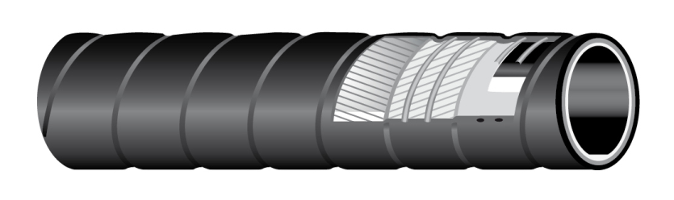

TUWAGON MASTER
Suction and delivery hose designed according to EN 12115 standards for oil and petrol, aromatic content up to 50%.
TESTED AND CERTIFIED BY INERIS FOR USE IN ATEX AREA (EX-ZONE 0, 1 and 2)
TUBE: NBR 1, black, conductive
REINFORCEMENT: synthetic plies - a/s copper wire to discharge static electricity - galvanized wire helices
COVER: wide corrugated, CR, black, conductive, abrasion, ageing, ozone and oil resistant, cloth finish
WP: 10 BAR (150 PSI) BP: 40 BAR (600 PSI)
VACUUM: 675 mmHg (0,9 bar)
T: -30°C / +100°C ( -22°F / +212°F )

Slide 17
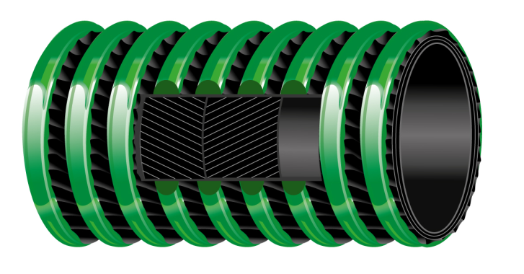
SPIRALTECH® FUEL
Light and flexible lorry collecting hose suitable for oil and petrol, aromatic content up to 50%.
TUBE: NBR , black, conductive
REINFORCEMENT: synthetic plies - a/s copper wire to discharge static electricity
COVER: corrugated, black, abrasion, ageing, ozone and oil resistant, outer thermoplastic helix
WP: 10 BAR (150 PSI) BP: 30 BAR (450 PSI)
VACUUM: depending on the ID: 675 mmHg (0,9 bar) up to ID 51 mm
T: -25°C / +80°C ( -13°F / +176°F )

Slide 18
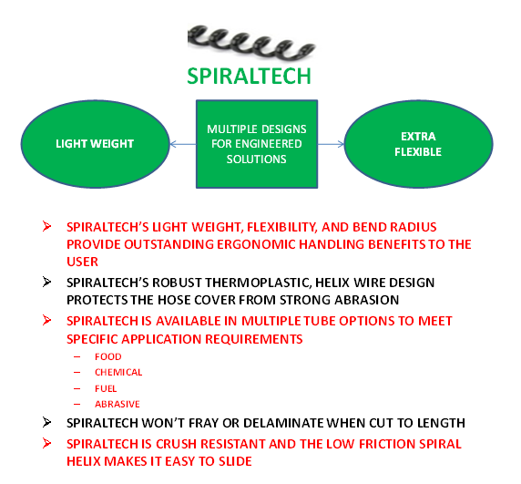
SPIRALTECH® MAIN FEATURES

Slide 19
FLUOROPOLYMERS
FEATURES
Temperature range : -40°C / +150°C
excellent chemical and mechanical properties
no contamination or alteration of the quality of the product delivered
the TUBE is smooth and impermeable

Slide 20
FLUOROPOLYMERS
STANDARDS
FDA 21 CFR 177.1550
USP XXXII class VI (black); USP XXXVI class VI (white)
ISO 10993 Sections 5,10,11:2009
1907/2006/CE (REACH)
EUROPEAN REGLEMENT 1935/2004/CE AND 10/2011/CE
3A Sanitary Standard Class II (white)

Slide 21
FLUOROPOLYMERS
APPLICATIONS
CHEMICALS and solvents except for:
Alkali metals such as elemental sodium, potassium, lithium, etc.
Extremely potent oxidizers, fluorine (F₂) and related compounds (e.g., chlorine trifluoride, CIF₃).
80% NaOH (Sodium Hydroxide) or KOH (Potassium Hydroxide), metal hydrides such as Borances (e.g., B₂H₆), Aluminum Chloride, Ammonia (NH₃), certain Amines (R-NH₂) and imines (R=NH) and 70% Nitric Acid at temperatures near the suggested service limit.
However it is necessary to take in consideration all variable that may be encountered in actual use, such as and not limited to temperature, concentration, pressure, duration of exposure and stability of the fluid and possible contamination
All application should always be tested: the compound should always be tested with the chemical it is going to handle

Slide 22







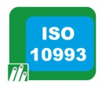

TUFLON PTFE CHEM FULL CONDUCTIVE
Suction and delivery hose DESIGNED ACCORDING TO EN 12115 for chemicals and solvents resistant to high temperatures. Phthalates free tube, tested in compliance with 1907/2006/CE (REACH).
TESTED AND CERTIFIED BY INERIS FOR USE IN ATEX AREA (EX-ZONE 0, 1 and 2)
TUBE: PTFE (polytetrafluorethylene), black, conductive. Phthalates free, tested in compliance with 1907/2006/CE (REACH). PTFE is a polymer with excellent resistance to high temperature, mechanical stress and to oxidation
REINFORCEMENT: synthetic plies - a/s copper wires to discharge static electricity - galvanized wire helices
COVER: smooth, EPDM, black, conductive, abrasion, ageing and ozone resistant, cloth finish
WP: 16 BAR (250 PSI) BP: 64 BAR (1000 PSI)
VACUUM: 675 mmHg (0,9 bar) T: -40°C / +150°C ( -40°F / +302°F )

Slide 23
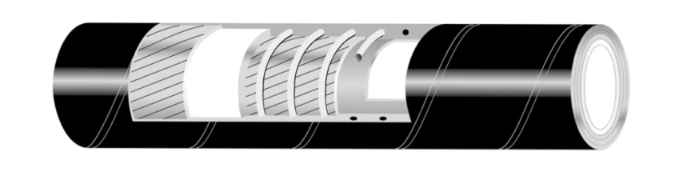

TUFLON PTFE CHEM
Suction and delivery hose DESIGNED ACCORDING TO EN 12115 for chemicals and solvents resistant to high temperatures.
Phthalates free tube, tested in compliance with 1907/2006/CE (REACH).
Tube: PTFE (polytetrafluorethylene), white. Phthalates free, tested in compliance with 1907/2006/CE (REACH). PTFE is a polymer with excellent resistance to high temperature, mechanical stress and to oxidation
REINFORCEMENT: synthetic plies - a/s copper wires to discharge static electricity - galvanized wire helices
COVER: smooth, EPDM, black, conductive, abrasion, ageing, ozone and oil resistant, cloth finish
WP: 16 BAR (250 PSI) BP: 64 BAR (1000 PSI)
VACUUM: 675 mmHg (0,9 bar) T: -40°C / +150°C ( -40°F / +302°F )

Slide 24
UHMWPE
FEATURES
Temperature range : -35°C / +100°C
COMPLETELY ODOURLESS AND TASTE FREE
Translucent/ Black conductive/white with conductive chips
resistant to a wide range of chemical products: aniline, formaldehyde, hydrogen peroxyd, acids, esters, alcohols and solvents, solutions containing chlorine, saline solutions, alcohol and solvents like acetone, hydrocarbons, oils and fats

Slide 25
UHMWPE
STANDARDS
UHMWPE translucent: Phthalates free, tested in compliance with 1907/2006/ce (reach). FDA 21 cfr 177.1520, BfR Cat III and DM 21.03.73 e seguenti, european reglement 1935/2004/ce and 10/2011/ce; JAPAN-Ministry of Health and Welfare Notice No.370,1959 and No.201, 2006;
uhmwpe black conductive: Phthalates free, tested in compliance with 1907/2006/ce (reach). FDA 21 cfr 177.1520, BfR Cat III and DM 21.03.73 e seguenti, european reglement 1935/2004/ce and 10/2011/ce;
Uhmwpe white with conductive chips: Phthalates free, tested in compliance with 1907/2006/ce (reach). FDA 21 cfr 177.1520, BfR Cat III and DM 21.03.73 e seguenti, european reglement 1935/2004/ce.

Slide 26
UHMWPE
APPLICATIONS
PETROCHEMICAL INDUSTRY
CHEMICAL TRANSPORT TANKS
Liquid industrial waste recycling plant
PAINT FACTORIES (no silicone free)
WIDE RANGE OF APPLICATIONS
However it is necessary to take in consideration all variable that may be encountered in actual use, such as and not limited to temperature, concentration, pressure, duration of exposure and stability of the fluid and possible contamination
All application should always be tested: the compound should always be tested with the chemical it is going to handle

Slide 27
UPE main characteristics
UHMWPE (UPE)
STOCK MANAGEMENT | ONE HOSE FOR MULTIPLE APPLICATION: PHARMA, COSMETIC, CHEMICAL AND FOOD
FOOD APPROVALS | YES- see catalogue
PHTALATES FREE TUBE TESTED ACCORDING TO REACH REGULATION | YES
TASTE AND ODOUR | REDUCED
STEAM CLEANING | YES
MAX TEMPERATURE DEPENDING BY MEDIA CONVEYED | UP TO
ABRASION RESISTANCE | EXCELLENT
PERMEATION RATE | VERY GOOD
CONDUCTIVE | AVAILABLE ON REQUEST

Slide 28







TUCHEM UPE FULL CONDUCTIVE
Suction and delivery hose DESIGNED ACCORDING TO EN 12115 standards for chemical products.
Phthalates free tube, tested in compliance with 1907/2006/CE (REACH).
TESTED AND CERTIFIED BY INERIS FOR USE IN ATEX AREA (EX-ZONE 0, 1 and 2)
TUBE: UPE, black, conductive. Phthalates free, tested in compliance with 1907/2006/CE (REACH)
REINFORCEMENT: textile plies - a/s copper wire to discharge static electricity - galvanized wire helices
COVER: smooth, EPDM, black, conductive, abrasion, ageing, and ozone resistant, cloth finish
WP: 16 BAR (250 PSI) BP: 64 BAR (1000 PSI)
VACUUM: 675 mmHg (0,9 bar)
T: -35°C / +100°C ( -31°F / +212°F )

Slide 29
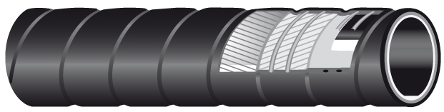
TUCHEM UPE FULL CONDUCTIVE
FORM
Suction and delivery hose DESIGNED ACCORDING TO EN 12115 standards for chemical products. Phthalates free tube, tested in compliance with 1907/2006/CE (REACH).
SUITABLE HOSE FOR USE IN ATEX AREA (EX-ZONE 0, 1 and 2).
TUBE: UPE, black, conductive. Phthalates free, tested in compliance with 1907/2006/CE (REACH)
REINFORCEMENT: textile plies - a/s copper wire to discharge static electricity - galvanized wire helices
COVER: WIDE CORRUGATED, EPDM, black, conductive, abrasion, ageing, and ozone resistant, cloth finish
WP: 10 BAR (150 PSI) BP: 40 BAR (600 PSI)
VACUUM: 675 mmHg (0,9 bar)
T: -35°C / +100°C ( -31°F / +212°F )

Slide 30
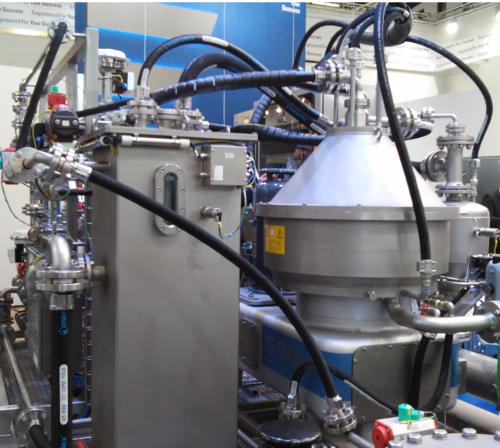
APPLICATION
FLOATING SEPARATOR SOLID-LIQUID
TUCHEM UPE FULL CONDUCTIVE

Slide 31
GLIDETECH® UPE FULL CONDUCTIVE
Suction and delivery hose DESIGNED ACCORDING TO EN 12115 standards for chemical products.
Phthalates free tube, tested in compliance with 1907/2006/CE (REACH).
SUITABLE HOSE FOR USE IN ATEX AREA (EX-ZONE 0, 1 and 2).
TUBE: UPE, black, conductive. Phthalates free, tested in compliance with 1907/2006/CE (REACH)
REINFORCEMENT: synthetic plies - a/s copper wire to discharge static electricity - galvanized wire helices
COVER: wide corrugated, black, conductive, low friction material, non marking when dragged on the floor, abrasion, ageing, ozone, oil and chemical resistant, easy to clean, glossy cover
WP: 10 BAR (150 PSI) BP: 40 BAR (600 PSI)
VACUUM: 675 mmHg (0,9 bar) T: -35°C / +100°C ( -31°F / +212°F )

Slide 32
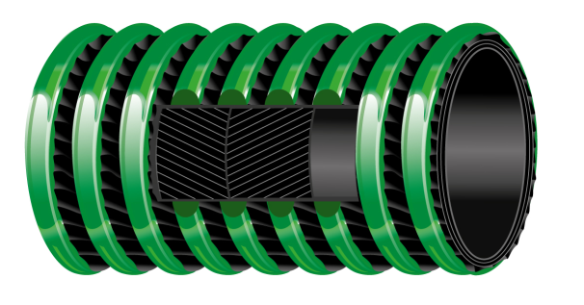
SPIRALTECH® UPE FULL CONDUCTIVE
Light and flexible lorry collecting hose suitable for chemical products.
Phthalates free tube, tested in compliance with 1907/2006/CE (REACH).
TUBE: UPE, black, conductive. Phthalates free, tested in compliance with 1907/2006/CE (REACH)
REINFORCEMENT: synthetic plies - a/s copper wire to discharge static electricity
COVER: corrugated, black, abrasion, ageing, ozone and oil resistant, outer thermoplastic helix
WP: 10 BAR (150 PSI) BP: 30 BAR (450 PSI)
VACUUM: depending on the ID: 675 mmHg (0,9 bar) up to ID 51 mm
T: -25°C / +80°C ( -13°F / +176°F )

Slide 33
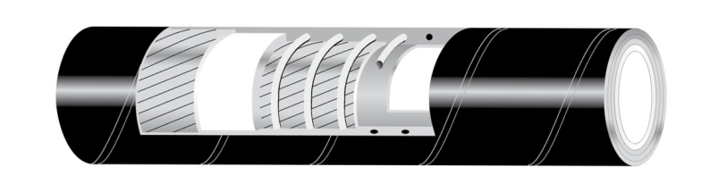


TUCHEM UPE
Suction and delivery hose DESIGNED ACCORDING TO EN 12115 standards for chemical products.
Phthalates free tube, tested in compliance with 1907/2006/CE (REACH).
TUBE: UPE, translucent. Phthalates free, tested in compliance with 1907/2006/CE (REACH)
REINFORCEMENT: textile plies - a/s copper wire to discharge static electricity - galvanized wire helices
COVER: smooth, EPDM, black, conductive, abrasion, ageing, and ozone resistant, cloth finish
WP: 16 BAR (250 PSI) BP: 64 BAR (1000 PSI)
VACUUM: 675 mmHg (0,9 bar)
T: -35°C / +100°C ( -31°F / +212°F )

Slide 34
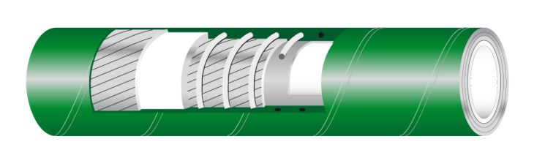

GPS EVOLUTION
Suction and delivery hose designed for chemical products.
Phthalates free tube, tested in compliance with 1907/2006/CE (REACH).
TUBE: UPE, translucent. Phthalates free, tested in compliance with 1907/2006/CE (REACH)
REINFORCEMENT: textile plies - a/s copper wire to discharge static electricity - galvanized wire helices
COVER: smooth, green, abrasion, ageing, and ozone resistant, cloth finish
WP: 10 BAR (150 PSI) BP: 30 BAR (450 PSI)
VACUUM: 675 mmHg (0,9 bar)
T: -30°C / +90°C ( -22°F / +194°F )

Slide 35
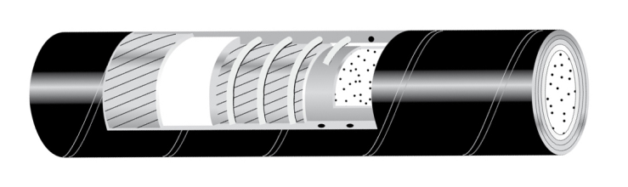
TUCHEM UPE CHIPS FULL CONDUCTIVE
Suction and delivery hose DESIGNED ACCORDING TO EN 12115 standards for chemical products.
Phthalates free tube, tested in compliance with 1907/2006/CE (REACH).
TUBE: UPE, white with conductive chips. Phthalates free, tested in compliance with 1907/2006/CE (REACH)
REINFORCEMENT: textile plies - a/s wire to discharge static electricity - galvanized wire helices
COVER: smooth, EPDM, black, conductive, abrasion, ageing, and ozone resistant, cloth finish
WP: 16 BAR (250 PSI) BP: 64 BAR (1000 PSI)
VACUUM: 675 mmHg (0,9 bar)
T: -35°C / +100°C ( -31°F / +212°F )

Slide 36
EPDM
FEATURES
Temperature range : -40°C / +120°C
Suitable for acids at medium and low concentration, alcohol, acetate, aldehyde, ester, hot water, COOLANTS

Slide 37
EPDM
APPLICATIONS
CHEMICAL TRANSPORTATION
CHEMICAL PLANTS
OTHER APPLICATIONS NOT PARTICULARLY AGGRESSIVE
However it is necessary to take in consideration all variable that may be encountered in actual use, such as and not limited to temperature, concentration, pressure, duration of exposure and stability of the fluid and possible contamination
All application should always be tested: the compound should always be tested with the chemical it is going to handle

Slide 38


TUCHEM EPDM
Suction and delivery hose designed according to EN 12115 standards for chemical products.
TESTED AND CERTIFIED BY INERIS FOR USE IN ATEX AREA (EX-ZONE 0, 1 and 2)
TUBE: EPDM, black, conductive
REINFORCEMENT: textile plies - a/s copper wire to discharge static electricity - galvanized wire helices
COVER: smooth, EPDM, black, conductive, abrasion, ageing and ozone resistant, cloth finish
WP: 16 BAR (250 PSI) BP: 64 BAR (1000 PSI)
VACUUM: 675 mmHg (0,9 bar)
T: -40°C / +120°C ( -40°F / +248°F )

